Slide 1
6th Week of General Assembly
4th November 2025

Slide 2
Weekly Report: Management Team
Week number: 06
Date: 04/11/2025
Supervisor: Prof. Quell
Presented by: Bakhtyar Karim & Federico De Mita & / Josef Remberger

Slide 3
List of contents
Looking out for our mates
Growing together
Team progress from
Listing to your feedback
Technical weekly report
Introduction to necell
Necell mass distribution
Benchmarks
Next Week
Bakhtyar karim

Slide 4
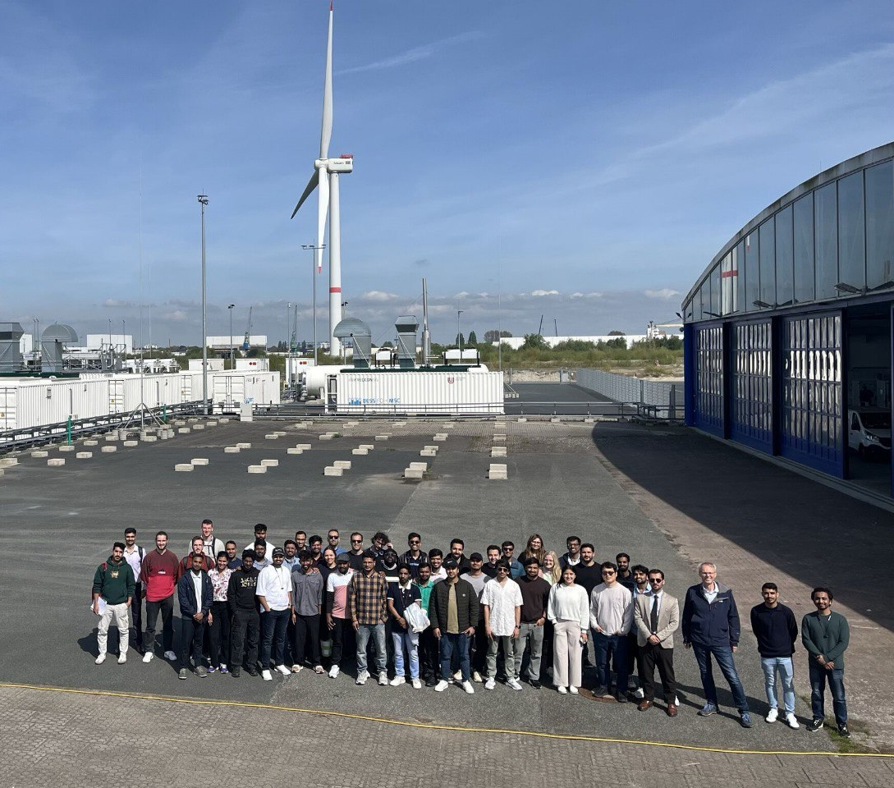
1. Looking out for our mates
We've heard you. We know some teams are under immense pressure and feeling the strain of delays.
Our first and most important job last week was to connect, listen, and recommit our support.
We're actively working to balance the load and clear roadblocks. You are not in this alone.
Bakhtyar Karim

Slide 5


1.i. Gorwing stronger together
Lidar + Feedback Control
Storage + Electrical Drivetrain
Bringing our Lidar Assisted Control and Feedback Control teams into one powerhouse. This will help us build a smarter, more responsive system from the ground up.
Our Storage and Electrical Drivetrain experts are now one team. The goal: occupy spaces helping each other, making next steps easier.
Bakhtyar Karim

Slide 6


1.ii. Team progress form
Project Health Check: Last week, we decided to get a clearer picture of our project's health. We knew some teams were having a tough time and falling behind, so we needed facts, not guesses.
What We Did
We created a short form (only 6 main questions) and sent it to all team leaders.
Why We Did It
The main goal was to find the exact problems that are causing delays and stress. We wanted real, specific information to help us fix things.
Bakhtyar Karim

Slide 7






1.iii. Listining to your feedback
Software & Setup
Team Organization
Action Plan
We've pinpointed issues with software installation and reporting. Our system integrator is here to fix software issues
Your feedback is gold. We keep our eyes on mentioned problems among all teams and try to avoid any problem that causes delay.
We see where our internal structure is causing confusion. We're mapping out clearer workflows.
Bakhtyar Karim

Slide 8

1.iv. Technical weekly report
Helping Your 'Future Self'
This is a reminder for all teams to get into the great habit of weekly technical reporting.
Why? Waiting until January means a huge amount of stress and overload. No one wants that.
Think of it as 5% effort now to avoid 200% panic in the new year!
Bakhtyar Karim

Slide 9
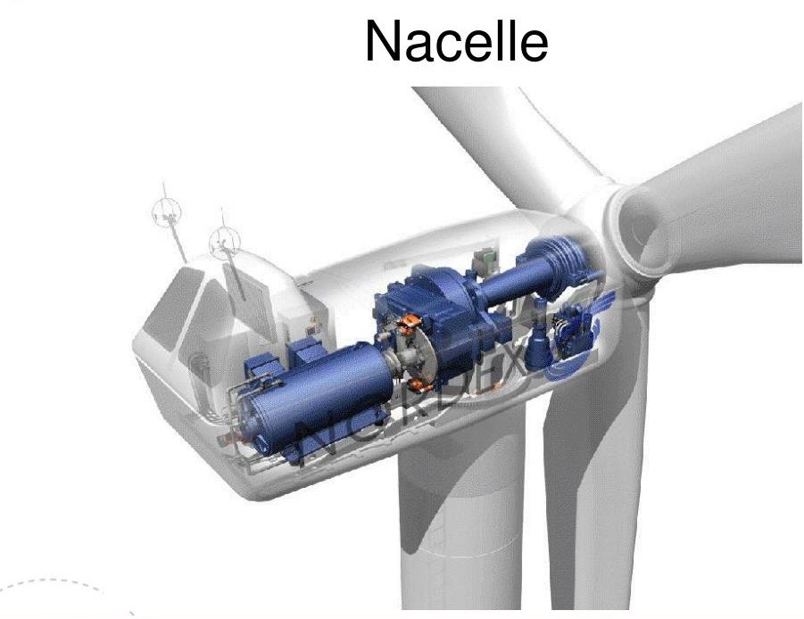
2. Introduction to Necell
The Nacelle, is the structural housing positioned at the top of a wind turbine tower, situated directly behind the rotor blades. It serves as the protective enclosure for the entire power generation system, commonly referred to as the drive train.
In a geared wind turbine, such as one utilizing a Doubly Fed Induction Generator (DFIG) paired with a 3 stage planetary gearbox, the nacelle must be robust enough to support and align these massive components while transmitting the enormous static and dynamic loads from the rotor (thrust, torque, and bending moments) down to the tower.
[1], [2], [3],
Bakhtyar Karim

Slide 10
2.i. Mass distribution
Component Group | Component | % Share of Total Turbine Mass | Notes on Interpretation
Nacelle Assembly Total | Nacelle | 35% | This is the overall mass of the components at the top of the tower plus the rotor.
Rotor | Blades | 8% | The three blades.
 | Hub | 3% | The central component connecting the blades to the shaft.
Drivetrain | Gearbox | 10% | The gearbox is the heaviest single component in the drivetrain assembly.
 | Generator (DFIG) | 5% | The electrical machine that converts torque to power.
 | Low speed shaft | 2.5% | Connects the hub to the gearbox.
 | Main frame | 2.5% | The structural support (bedplate) that holds the components.
 | Yaw drive and bearings | 2% | System for orienting the nacelle into the wind.
Rotor Total | Rotor | 11% | (Blades 8% + Hub 3%)
Drivetrain Total | Drivetrain | 23% | The total mass of the core power conversion system inside the nacelle.
[4] Mass distribution of 6 MW Wind turbine by R. S. Semken
Bakhtyar Karim

Slide 11
2.ii. Benchmarks
Turbine Model | Diameter (m) | Rated Power (MW) | Nacelle Mass (tonnes)
Enercon | 112 | 4.5 | 355
REpower (Senvion) | 126.5 | 5 | 315
AREVA | 120 | 5 | 349
Bard VM | 122 | 5.28 | 280
Enercon | 126 | 6 | 348
NREL | 126 | 5 | 240
Alstom | 150 | 6 | 400
We assume our wind turbine Necell mass will be between 240-400 approximatly around 320 Tonnes
[5], [6], [7], [8], [9], [10], [11],
Bakhtyar Karim

Slide 12



3. Next week
More coordination works
Support and Communicate with teams
Providing references for some teams (If possible!)
Introduction and explanation to guidelines
Bakhtyar Karim

Slide 13
Bibliography / Managment Team / PM
[1] J. Manwell, J. F. McGowan, and A. L. Rogers, Wind Energy Explained: Theory, Design and Application, 2nd ed. Chichester, UK: Wiley, 2010. Accessed: 2 Nov. 2025.
[2] U.S. Department of Energy, "How Wind Turbines Work." [Online]. Available: https://www.energy.gov/eere/wind/how-wind-turbine-works. Accessed: 2 Nov. 2025.
[3] V. Elias, "Wind Turbines," SlideShare, Nov. 18, 2014. [Online]. Available: https://www.slideserve.com/valentine-elias/wind-turbines. [Accessed: Nov. 2, 2025].
[4] R. S. Semken, M. Polikarpova, P. Röyttä, and J. Backman, "Direct-drive permanent magnet generators for high-power wind turbines: Benefits and limiting factors," IET Renew. Power Gener., vol. 6, no. 1, pp. 1–9, Jan. 2012. [Online]. Available: https://www.researchgate.net/publication/257935440_Direct-drive_permanent_magnet_generators_for_high-power_wind_turbines_Benefits_and_limiting_factors. [Accessed: Nov. 2, 2025].
[5] The Wind Power, "Saba Niroo 47-660 – Iran (Manjil area)," [Online]. Available: https://www.thewindpower.net. [Accessed: Oct. 23, 2025].
[6] The Wind Power, "Enercon E126/6000," [Online]. Available: https://www.thewindpower.net/turbine_en_223_enercon_e126-6000.php. [Accessed: Nov. 2, 2025].
[7] The Wind Power, "Repower 5M," [Online]. Available: https://www.thewindpower.net/turbine_en_14_repower_5m.php. [Accessed: Nov. 2, 2025].
[8] German Offshore Wind Energy Foundation, "Wind-turbines," [Online]. Available: https://www.offshore-stiftung.de/en/wind-turbines.php. [Accessed: Nov. 2, 2025].
[9] Wind Turbine Models, "Bard VM," [Online]. Available: https://en.wind-turbine-models.com/turbines/6-bard-vm. [Accessed: Nov. 2, 2025].
[10] HAWC2, "NREL 5 MW," [Online]. Available: https://www.hawc2.dk/models/nrel-5-mw. [Accessed: Nov. 2, 2025].
[11] Offshore Wind, "Alstom's 6 MW Offshore Wind Turbine Loaded at Ostend (Belgium)," Oct. 1, 2013. [Online]. Available: https://www.offshorewind.biz/2013/10/01/alstoms-6-mw-offshore-wind-turbine-loaded-at-ostend-belgium/. [Accessed: Nov. 2, 2025].
Bakhtyar Karim

Slide 14
List of contents
Project planning
Interfaces
Final remarks
Federico De Mita

Slide 15
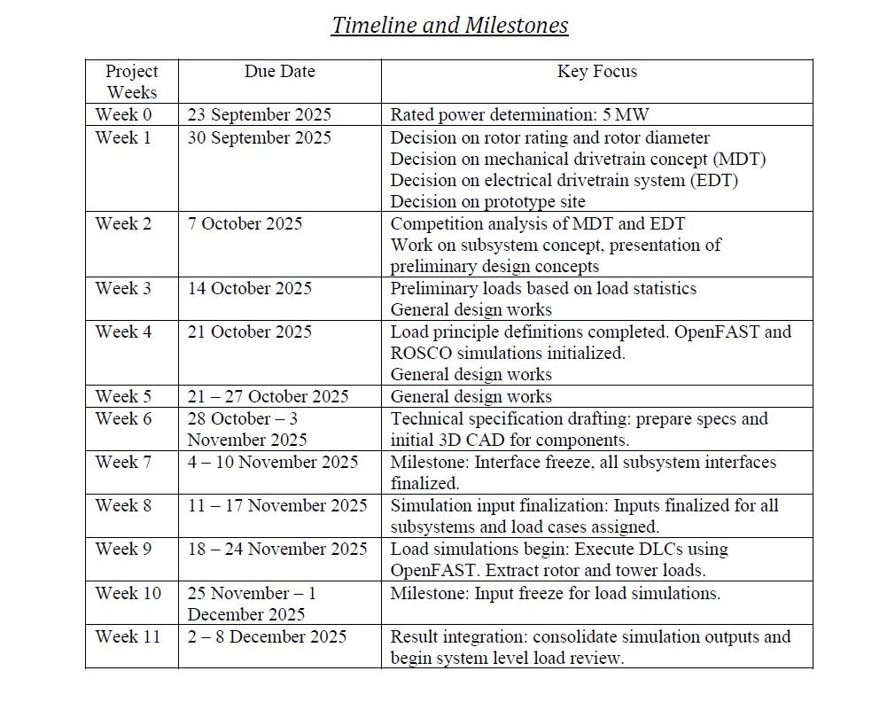
1. Project planning
Design parameters assumption/calculation
General timeline
Safety calculation for the designed parameters with Shakti loads
3 D models initialization
Dimensions approval
New loads calculated for our turbine
FINAL DESIGN APPROVAL!
Federico De Mita

Slide 16
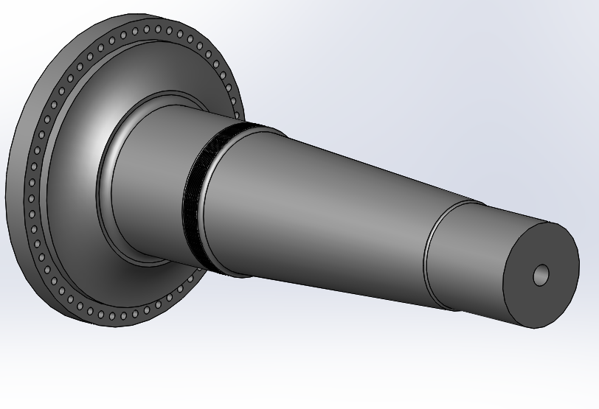
2. New interface updates
Rotor hub – Low Speed shaft flanged connection
name of the parameter | value | unit | status (fixed/not fixed) | SI remark
internal row bolt circle diameter | 1940 | mm | not fixed | based on the new value of shaft outer diameter
external row bolt circle diameter | 2140 | mm | not fixed | based on the new value of shaft outer diameter
max diameter flange | 2200 | mm | not fixed
flange thickness for shaft | 150 | mm | not fixed | same as shakti
flange thickness for hub | 150 | mm | not fixed | same as shakti
Bolt holes diameter | 42 | mm | not fixed | Because M39 are used
Bolt tighening tool max dimension | 102 | mm | fixed
flange radial thickness |  |  |  | Needs to be decided based on the dimension of the tool
Shaft from Optimus 92 LE
[1]
Federico De Mita

Slide 17
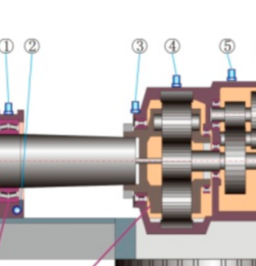
2. New interface updates
Gearbox – Low Speed shaft flanged connection
name of the parameter | value | unit | status (fixed/not fixed) | SI remark
Flange outer diameter | 1595 | mm | Fixed | Decided with professor from shaft diameter
Space for the tightening tool | 80 | mm | fixed
Flange radial thickness | 170 | mm | Not fixed
Shaft min diameter | 1255 | mm | Not fixed
Bolt circle diameter | 1435 | mm | Not fixed
Shaft – gearbox flange connection in a 3 point suspension system
Blade root – rotor hub flanged connection
name of the parameter | value | unit | status (fixed/not fixed) | SI remark
External (outer) Blade Diameter | ₃₅₂₀ | mm | not fixed | (Need to get permision from Professor)
External (inner) Blade Diameter | ₃₂₈₀ | mm | not fixed | (Need to get permision from Professor)
Bolt Circle diameter | ₃₄₀₀ | mm | fixed | Fixed by Prof. Quell & Team
Bolt Details | ₃₆ | mm | not fixed | (The Bolt Type is M36)
Root Thickness | 120 | mm | not fixed | (Need to get permision from Professor)
Hub – blade connection, Machinery components presentation
[2],[3]
Federico De Mita

Slide 18
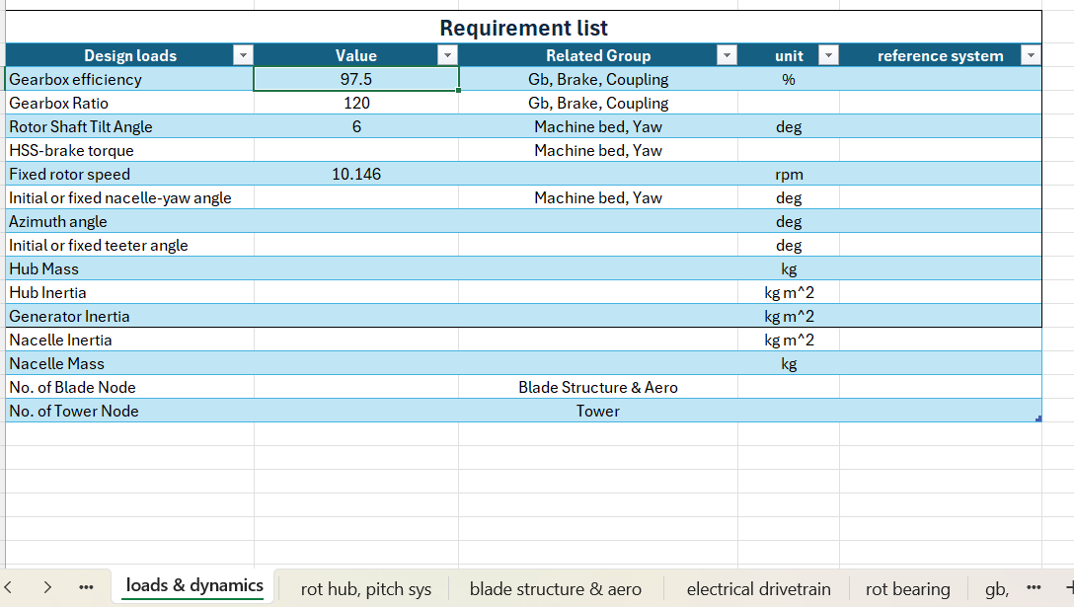
3. Final remarks
Next week the deadline must be met by all the mechanical groups: most of the components must be designed and the 3D models must have all been started
The parameters requested by the Load & Dynamics team for the simulations must be provided as soon as possible: look at ‘result file – Loads & dynamics’ and try to provide the parameters asked to your group
Federico De Mita

Slide 19
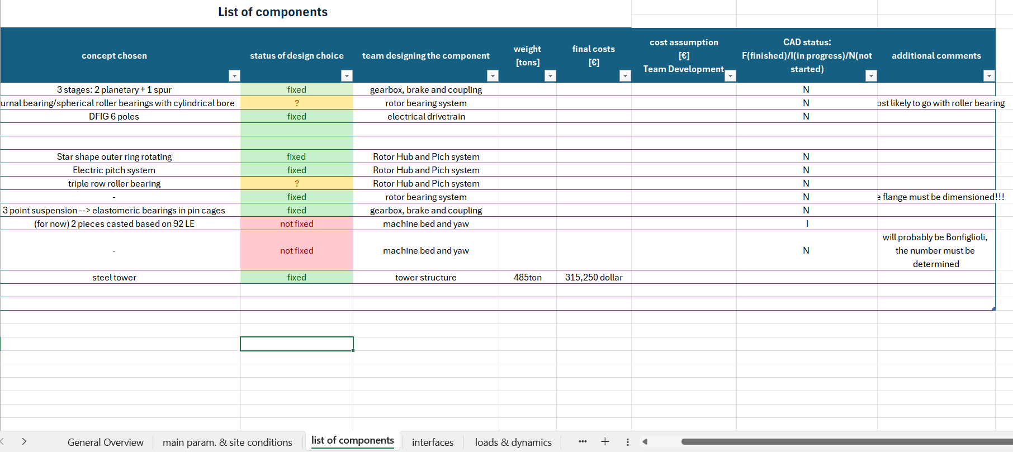
3. Final remarks
Update the status of the CAD models on the result file!!
If you have some new dimensions please upload them on the result file and possibly send them to your supervisor who can check them: WE NEED TO ALWAYS MAKE SURE THAT THE RESULTS ARE CORRECT
Federico De Mita

Slide 20
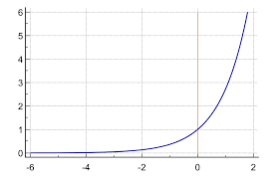
3. Final remarks
This week a great improvement in pace and quality of the work has been performed→ let’s try to continue with this regime!!!!
Progress
SUCCESS!!
Time (d)
The teams from now on!!!
Federico De Mita

Slide 21
Bibliography – Management team
[1] Optimus 92LE final presentation
[2] W. Teng, X. Ding, S. Tang, J. Xu, B. Shi, and Y. Liu, “Vibration Analysis for Fault Detection of Wind Turbine Drivetrains—A Comprehensive Investigation,” Sensors 2021, Vol. 21, Page 1686, vol. 21, no. 5, p. 1686, Mar. 2021, doi: 10.3390/S21051686. – last access: 02/11/2025 – 20:30
[3] P. Quell, “Machinery components lecture – Rotor hubs and flanges”, 2025
Federico De Mita

Slide 22
Weekly report: Team Project Development
Week number: 06
Date: 03/11/2025
Supervisor: Dr. Marina Blohm
Group members: Luis Urhahn, Ahmed Sallam, Ceren Cetin, Sohail Mansuri
Presenter:Sila Ceren Cetin

Slide 23
Tasks of the week
Update on the electricity prices/LCOE in Syria
Progress: WindPro Simulation
Logistics
QGIS
Sila Ceren Cetin

Slide 24
Update electricity prices Syria
Research on the current electricity prices in Syria:
Households: 1.6 €Cents/kWh
Industry: 4.6 €Cent/kWh
The Syrian Pound has a volatile and variable exchange rate, making a precise conversion unreliable.
[2] Source: Syria energy prices | GlobalPetrolPrices.com
Worldwide LCOE for Wind turbine (onshore, 2024):
LCOE: 4.3 – 9.2 €Cents/kWh
[3] Source: https://www.ise.fraunhofer.de/content/dam/ise/en/documents/publications/studies/EN2024_ISE_Study_Levelized_Cost_of_Electricity_Renewable_Energy_Technologies.pdf
Shows that our turbine needs to be very cost-efficient!
Sila Ceren Cetin

Slide 25
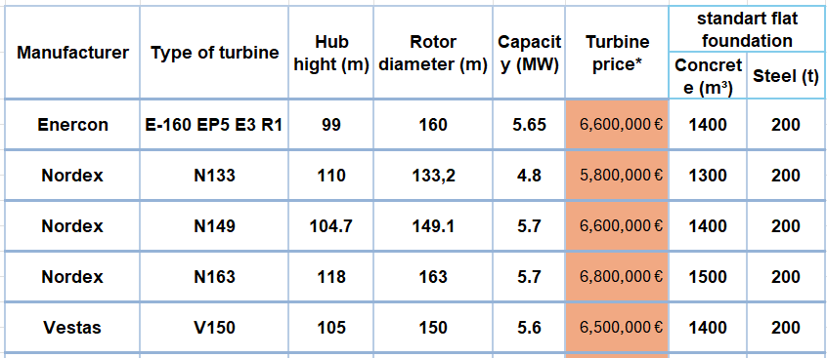
Rough estimation of wind turbine Price
Determining the true price of a 5 MW wind turbine is challenging due to differences between manufacturers.
Initial cost estimation for calculations is set at 6.5 million euros.
Price range for 5 MW turbines from different manufacturers is 5.5 to 7 million euros.
Project development lecture
Sila Ceren Cetin

Slide 26
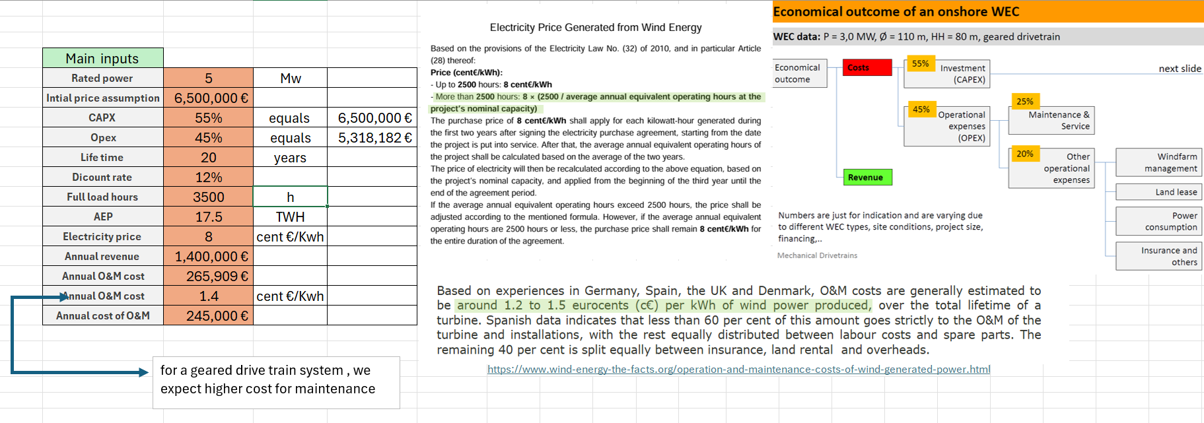
The initial assumptions and inputs for our Excel sheet
Electricity price based on Syria’s Electricity Law No. 32 (2010): guaranteed at 8 cent€/kWh for first 2 years
If annual production exceeds 2500 hours, price adjusted by formula; otherwise, remains at 8 cent€/kWh
European O&M cost reference: 1.2–1.5 cent€/kWh (Germany, Spain, UK, Denmark)
[4]
Cost breakdown: 55% investment (CAPEX), 45% operational expenses (OPEX), maintenance = 25% of OPEX
Own source
Sila Ceren Cetin

Slide 27
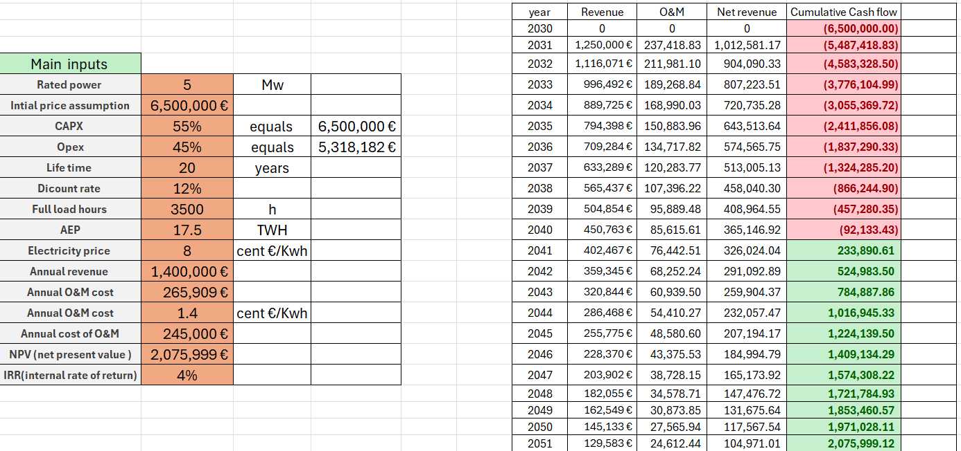
The main structure and the calculations of NPV and discount rate
Own source
Sila Ceren Cetin

Slide 28
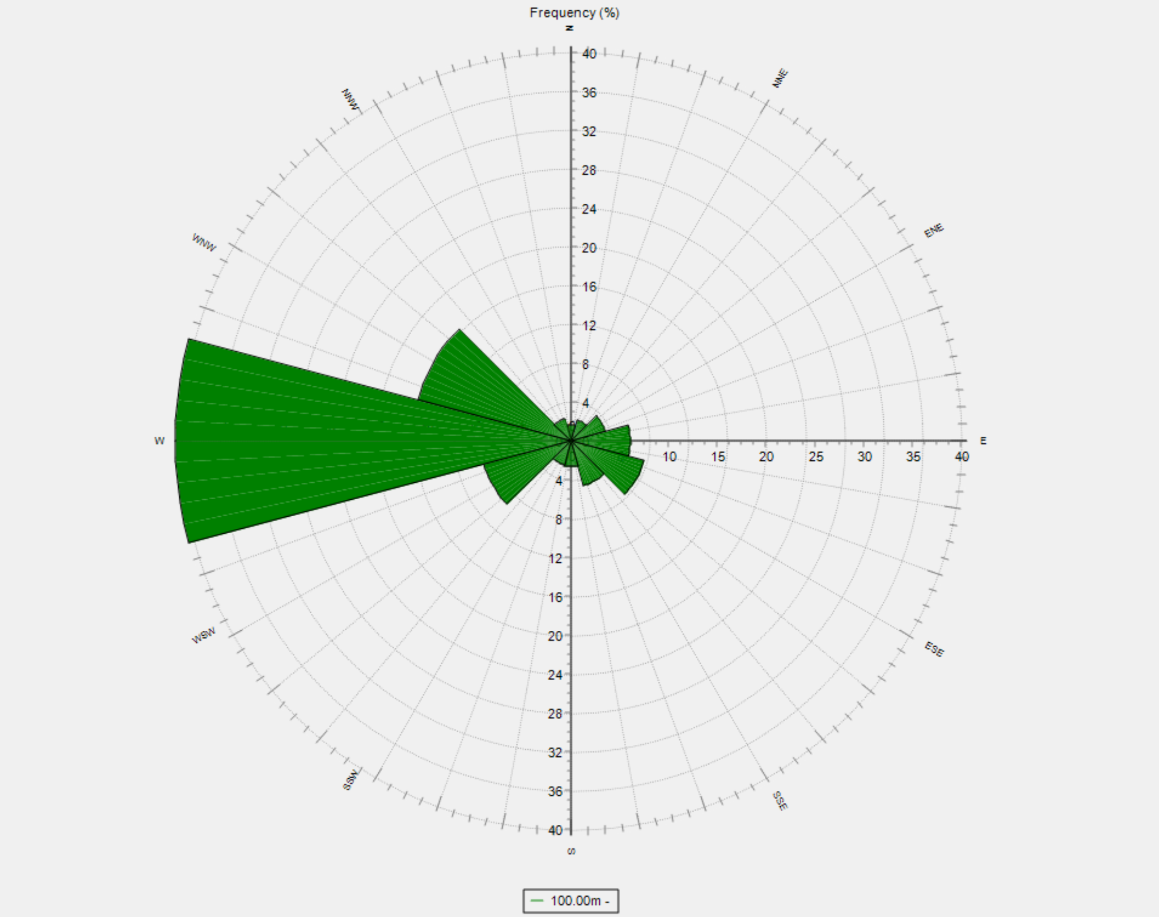
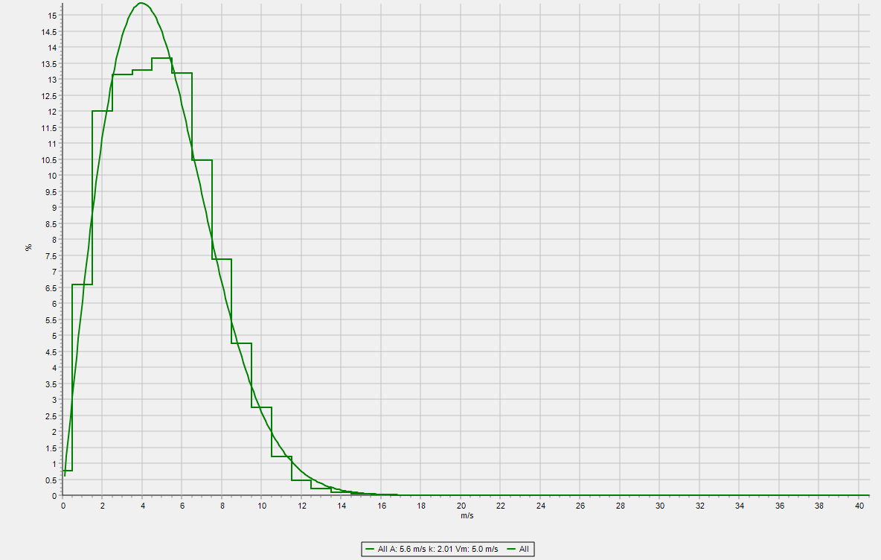
Progress: WindPro Simulation
Wind Ressource Implementation in the WindPro model:
Long Term Data – ERA5 (Gaussian Grid)
1995 up to 2025, 30 years
Different from measured data (lower)
8 km from location
Lonf Term Data – ERA5(T) (Rectangular Grid)
30 years, very similar to first LTD, 13 km
Trying to include the measured data
Failed so far, need to review again
Including StatGen
For the generation of Wind Statistics
Including ResGen
For the generation of Wind Energy Resources
Need to try again with measured data
Setup of WTG
Starting with 5 MW turbine (SG 5.0-145 @ HH102m, for assumption)
Will be echanged when final turbine data available
Figure 1: Screenshot of the wind rose at 100m in WindPro [8]
Figure 2: Screenshot of the Weibull distribution at 100m in WindPro [8]
Sila Ceren Cetin

Slide 29
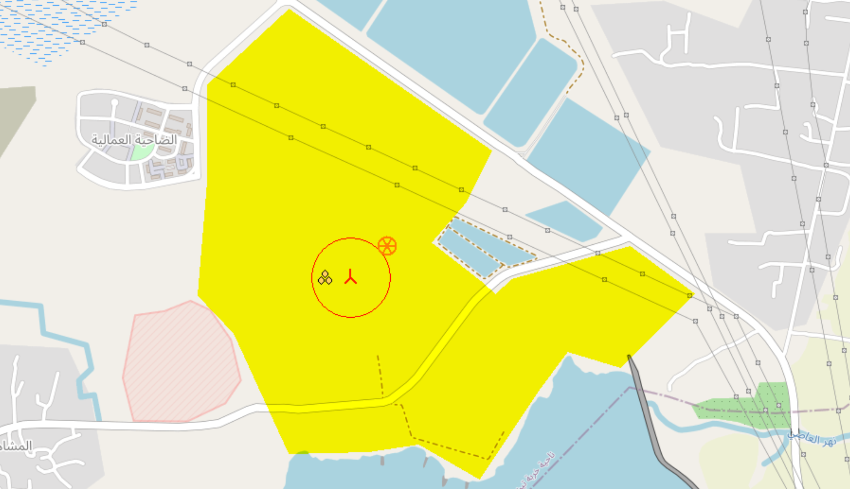
Progress: WindPro Simulation
Critical to build a larger Wind Farm
Close to the buildings
Close to the powerline
Figure 3: Screenshot of the Optimus Turbine location [8]
Sila Ceren Cetin

Slide 30
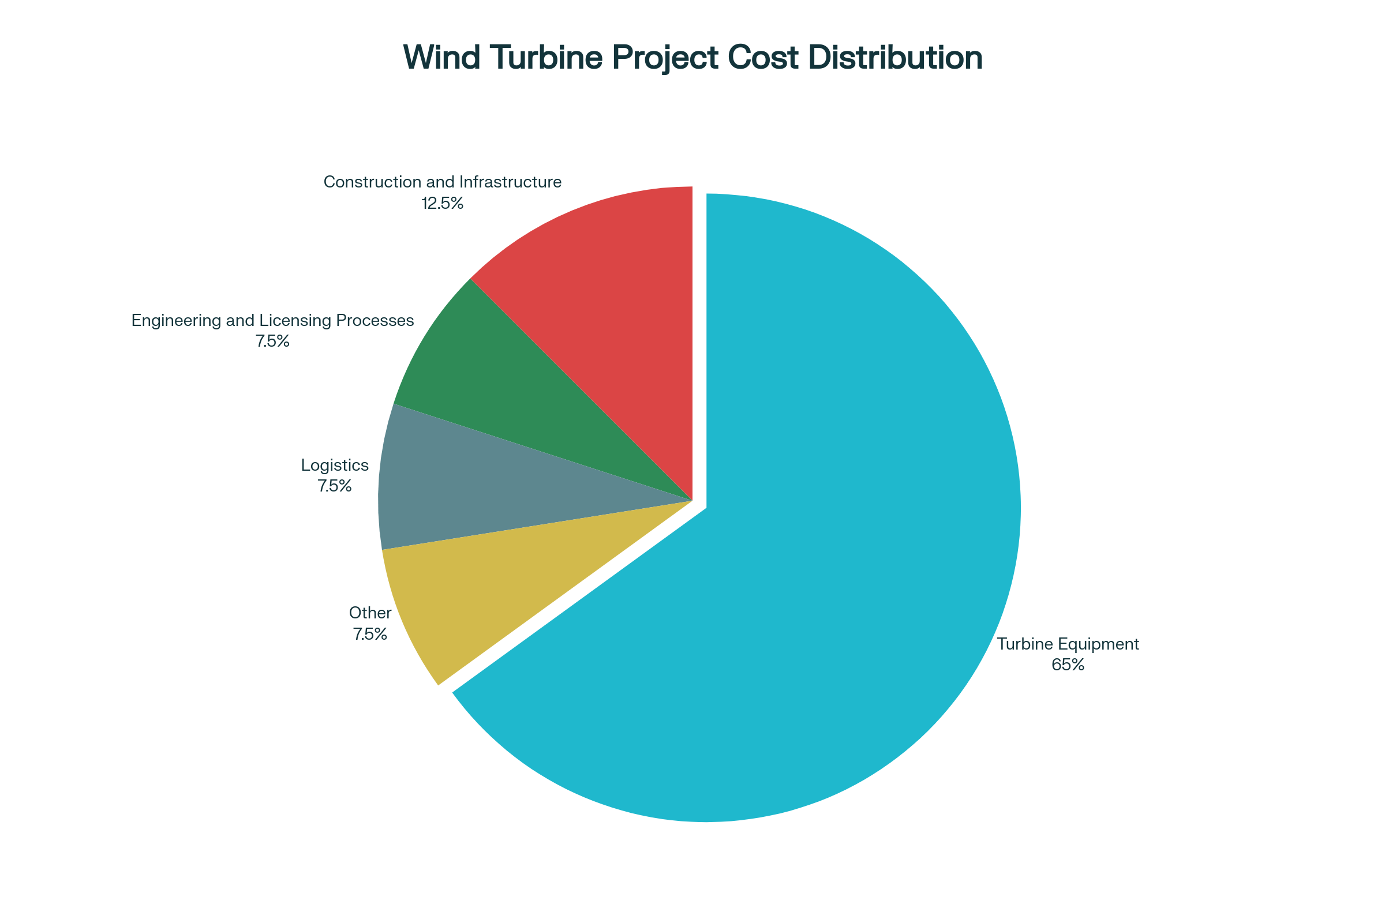
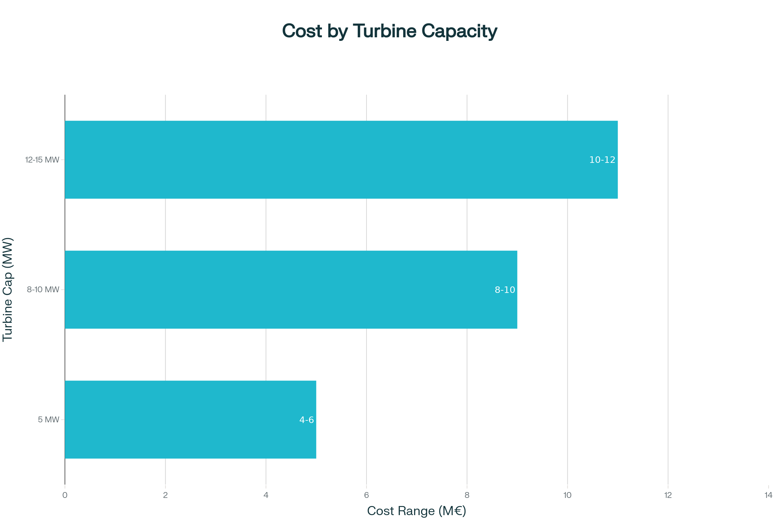
Wind Turbine Cost Distribution in Turkey
[8]

Slide 31
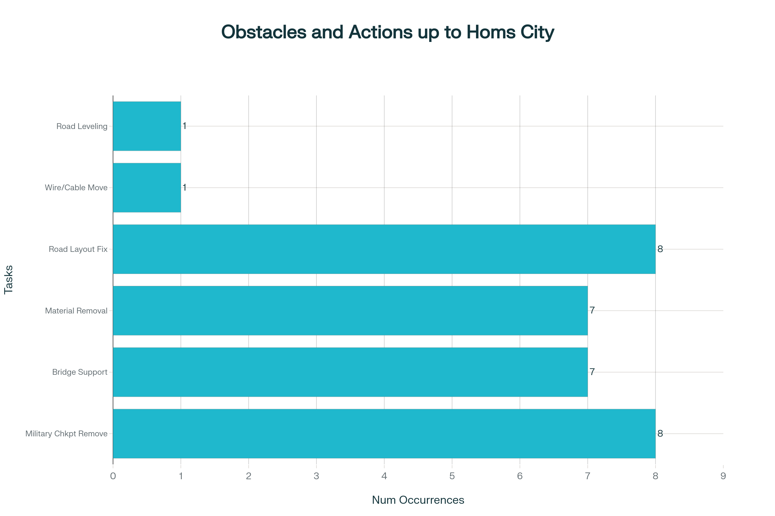
Transportation: Tartus Port-Homs City
Military checking point should be removed: 8
Bridge has to be supported: 7
Concrete/block/material/stockpile removal: 7
Road/bypass/turn/exits/layout intervention: 8
Electric wires and Telephone cable should be moved up: 1
Road leveling is needed: 1
[7]

Slide 32
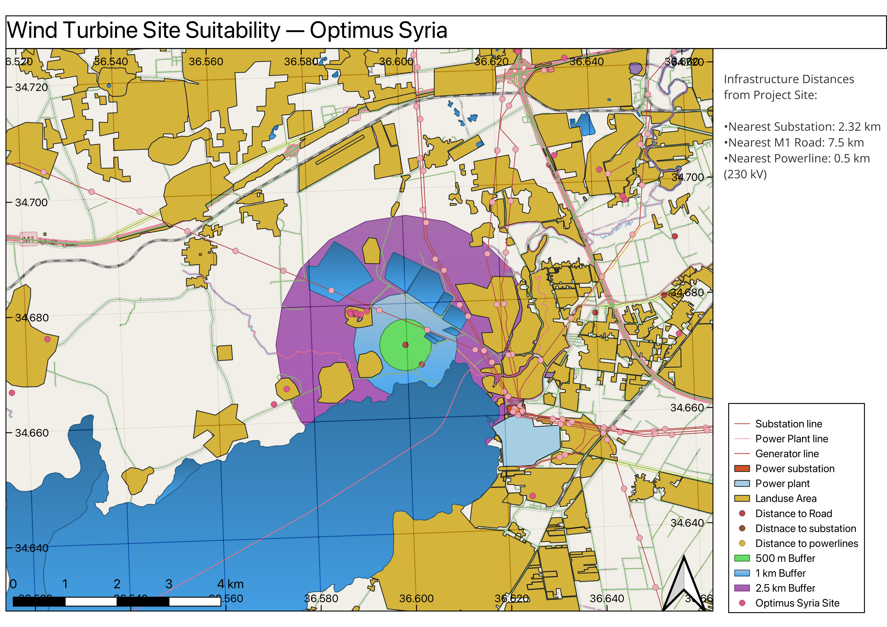
Progress : Detaile Site Analysis (QGIS)
[9]]
Sila Ceren Cetin

Slide 33
Bibliography – Project Development
[1] WindPro, University License for WindPro [Software] (latest on 30.10.25)
[2] Syrian Energy Prices, GlobalPetrolPrices. [Online]. Available: Syria energy prices | GlobalPetrolPrices.com (latest on 28.10.25)
[3] Study Levelized Cost of Electricity Renewable Energy Technologies, ISE-Fraunhofer [Document]. https://www.ise.fraunhofer.de/content/dam/ise/en/documents/publications/studies/EN2024_ISE_Study_Levelized_Cost_of_Electricity_Renewable_Energy_Technologies.pdf (latest on 28.10.25)
[4] https://www.wind-energy-the-facts.org/operation-and-maintenance-costs-of-wind-generated-power.html
[5] https://english.enabbaladi.net/archives/2025/09/loans-starting-at-e50-million-offered-for-renewable-energy-projects-in-syria/ [6] Damacus university shared files IRENA_Power_Generation_Costs_2021_pdf
[7] Inspection road between Tatous and dier Ali power plant, unpublished report, 2025.
[8] Wind Turbine Prices, Cost Analysis, and 1 MW Turbine Profit - Comprehensive Guide," Aldatmaz Global, [Online]. Available: https://aldatmazglobal.com/ruzgar-turbini-fiyatlari-maliyet-analizi-ve-1-mw-turbin-kazanci-kapsamli-rehber/. [Accessed: 30- Oct- 2025]
[9] QGIS, Public Software [Software]
Sila Ceren Cetin

Slide 34



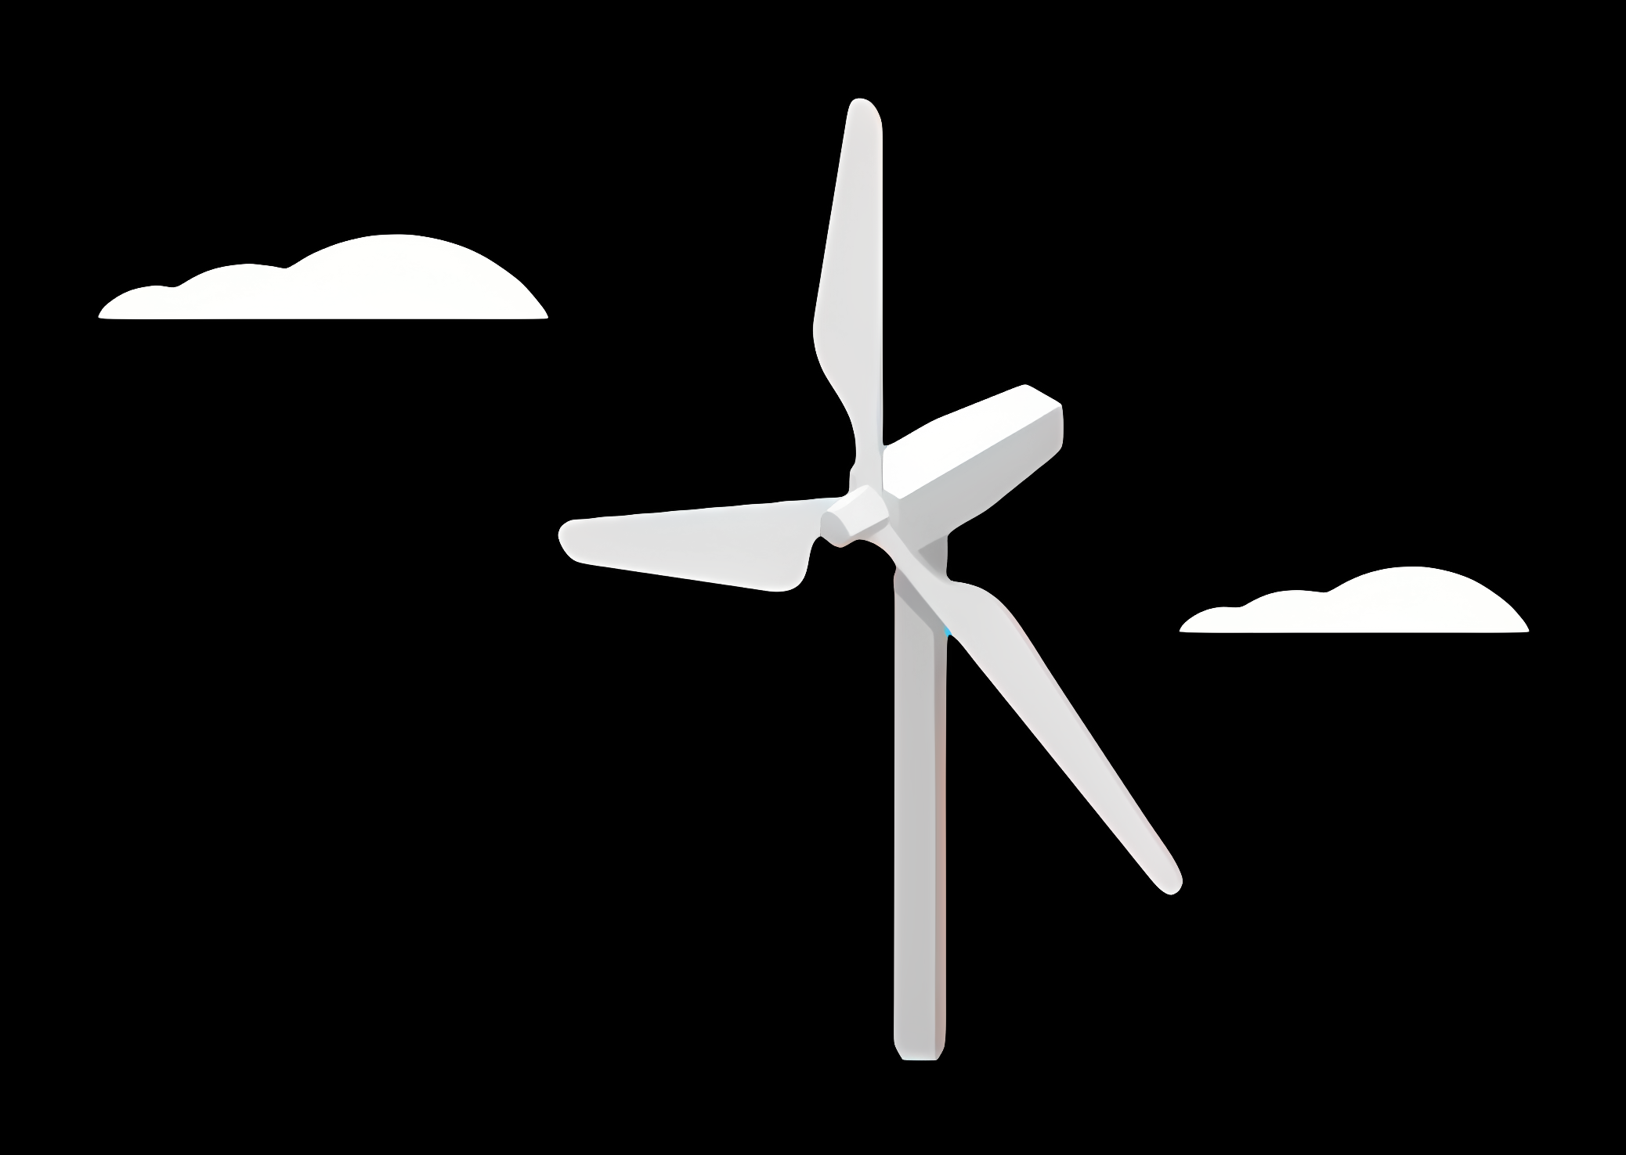
Weekly report: Load & Dynamics
Week number: 06
Date: 04/11/2025
Supervisor: Mr. Manjock
Group members: Md Aman, Arham Memon, Paresh Nakum
Presenter – Md Aman
04/11/2025
Md Aman, Arham Memon, Paresh Nakum
Optimus Syria

Slide 35
Agenda For Loads & Dynamics
Normal turbulence model (NTM) Wind Field Simulation
Power curve
MExtremes
DLC 5.1
Simulation for DLC 5.1 Cases
Conclusion & Future Plan
Bibliography
04/11/2025
Md Aman
Load & Dynamics Team/ Optimus Syria

Slide 36
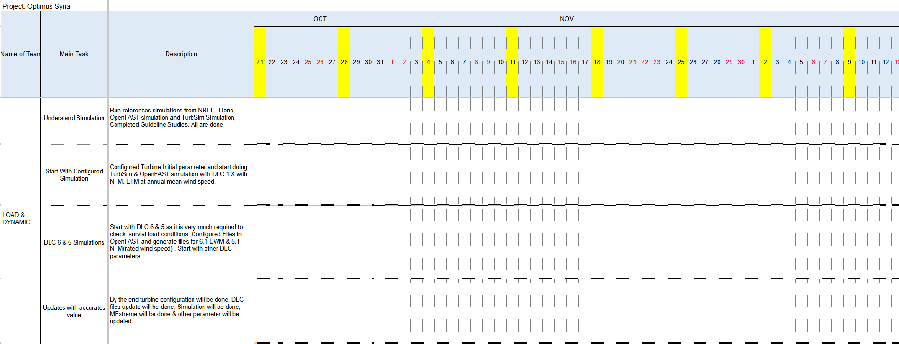
Timeline
DLC 5 with NTM & 6 with EWM
Other DLC cases analysis..
04/11/2025
Md Aman
Load & Dynamics Team/ Optimus Syria

Slide 37
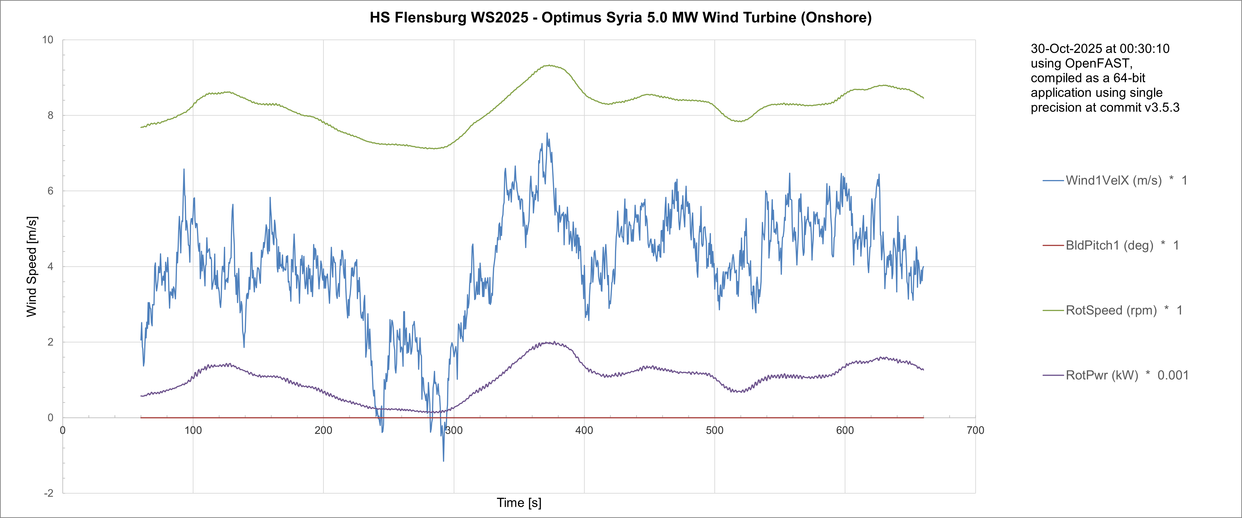
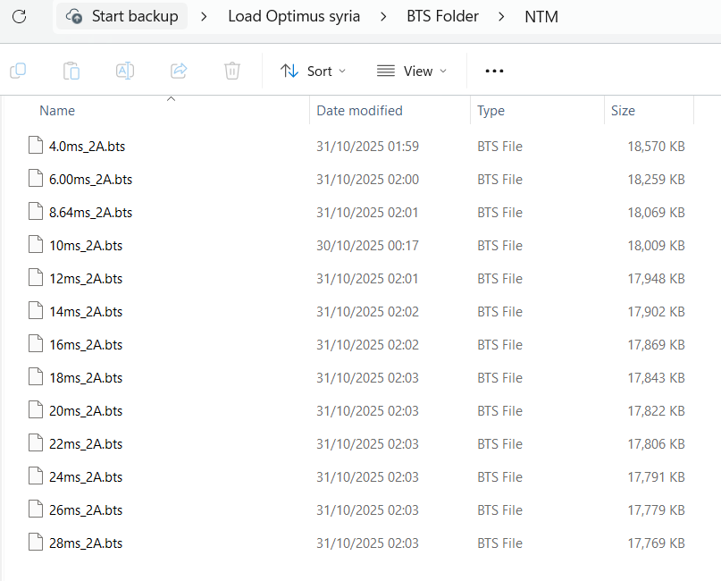
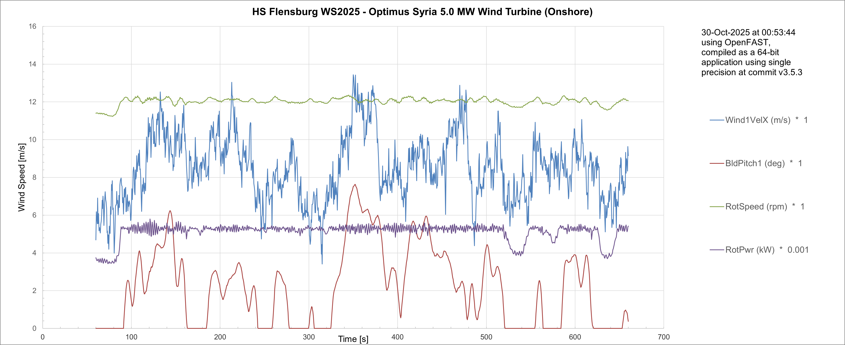
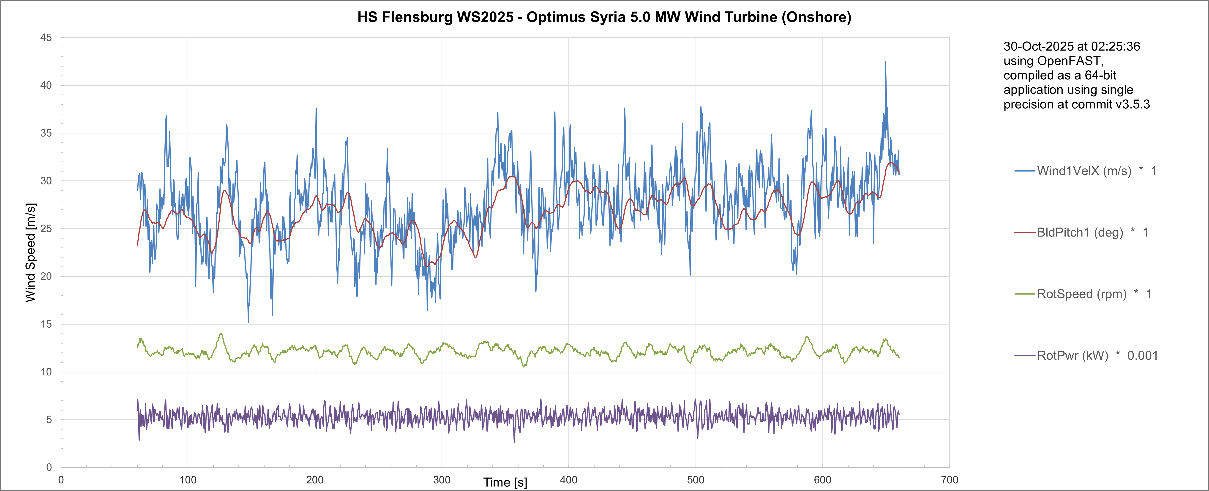
NTM Wind Field Simulations
4.0 m/s
Simulations at different Wind Speed in NTM
8.64 m/s
28.0 m/s
04/11/2025
37
Md Aman
Load & Dynamics Team/ Optimus Syria

Slide 38
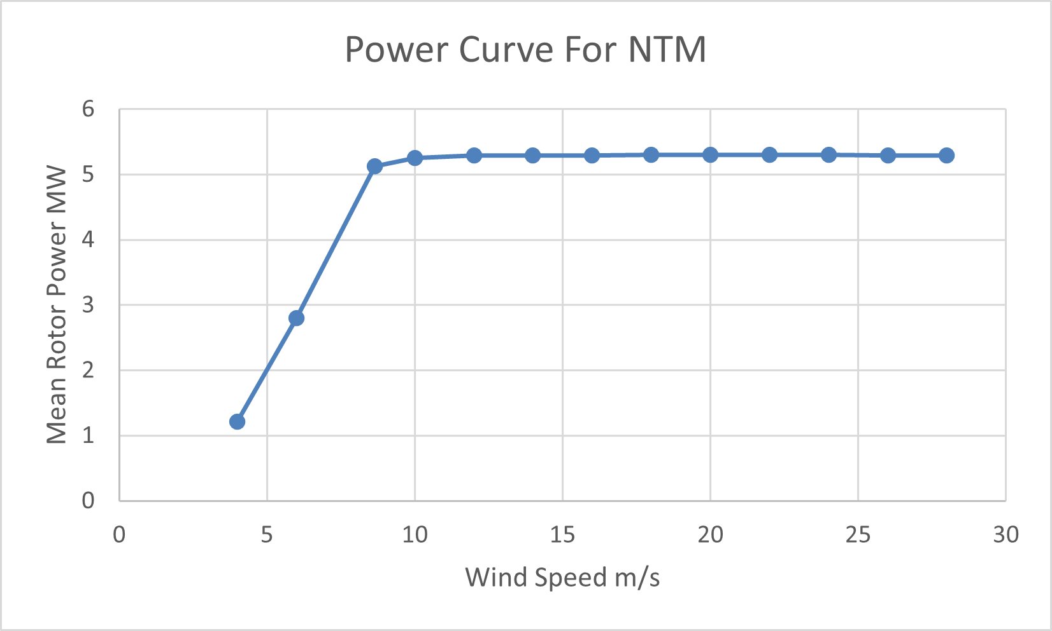
Power Curve for NTM
Simulations results at different Wind Speed in NTM
04/11/2025
38
Md Aman
Load & Dynamics Team/ Optimus Syria

Slide 39
MExtremes
MExtremes = Matlab tool for calculating load extremes (maximum/minimum values) from wind turbine simulations like OpenFAST.
Define Design Load Cases
(IEC 61400-1: DLC 1.x,2.x,3.x...)
Prepare input files
TurbSim or other tool → turbulence wind files.
OpenFAST input files (.fst) specifying DLC, controllers, initial conditions
Run OpenFAST simulations
Run one or many cases (each produces a time-series output .out
Collect and organize outputs
Gather .out files, label them by DLC and wind speed
Run MExtremes
Read files sequentially
Optionally use string channel names or calculated channels
Find extremes (max/min), record time, which file, and associated channels
Generate extreme-event tables & plots
Excel/text tables, charts, scatter plots, per DLC or wind-speed
Post-processing & checks
Apply partial safety factors (PSFs) if required
Compare extremes to design limits / safety factors
Certification / design decisionsReport results, pick critical load cases, update design if needed
04/11/2025
39
Md Aman
Load & Dynamics Team/ Optimus Syria

Slide 40
DLC 5.1
In IEC 61400-1 (Ed. 4, 2019), DLC 5.1 covers “Emergency Brake during operation”. It’s one of the ultimate load cases, designed to check survival loads while Intense shut down.
Activity in Servodyn.dat file
Pitch action adjusted
Generator switch off
Disc brake application started
Case | Turbine State | Typical Wind Model
DLC 5.1 | Operation /power production plus activation of emergency brake procedure | NTM
DLC 5.1a | Rated wind speed ~ 10 m/s | NTM
DLC 5.1b | Rated wind speed + 2 m/s | NTM
DLC 5.1c | Rated wind speed - 2 m/s | NTM
DLC 5.1d | Cut-out wind speed - 28 m/s | NTM
04/11/2025
40
Md Aman
Load & Dynamics Team/ Optimus Syria

Slide 41
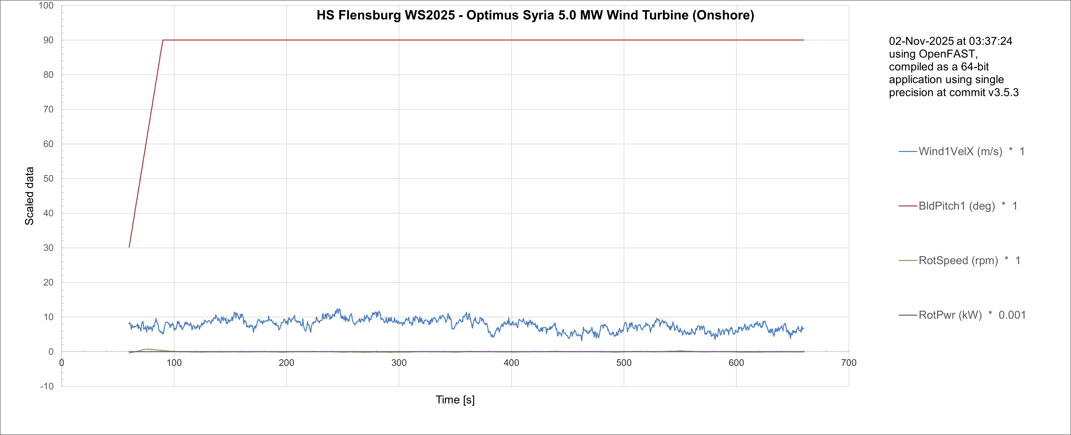
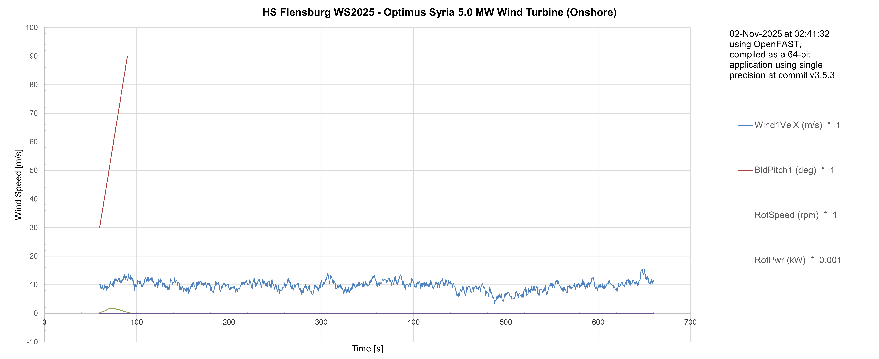
Simulation for DLC 5.1
8m/s
10m/s
04/11/2025
Md Aman
Load & Dynamics Team/ Optimus Syria

Slide 42
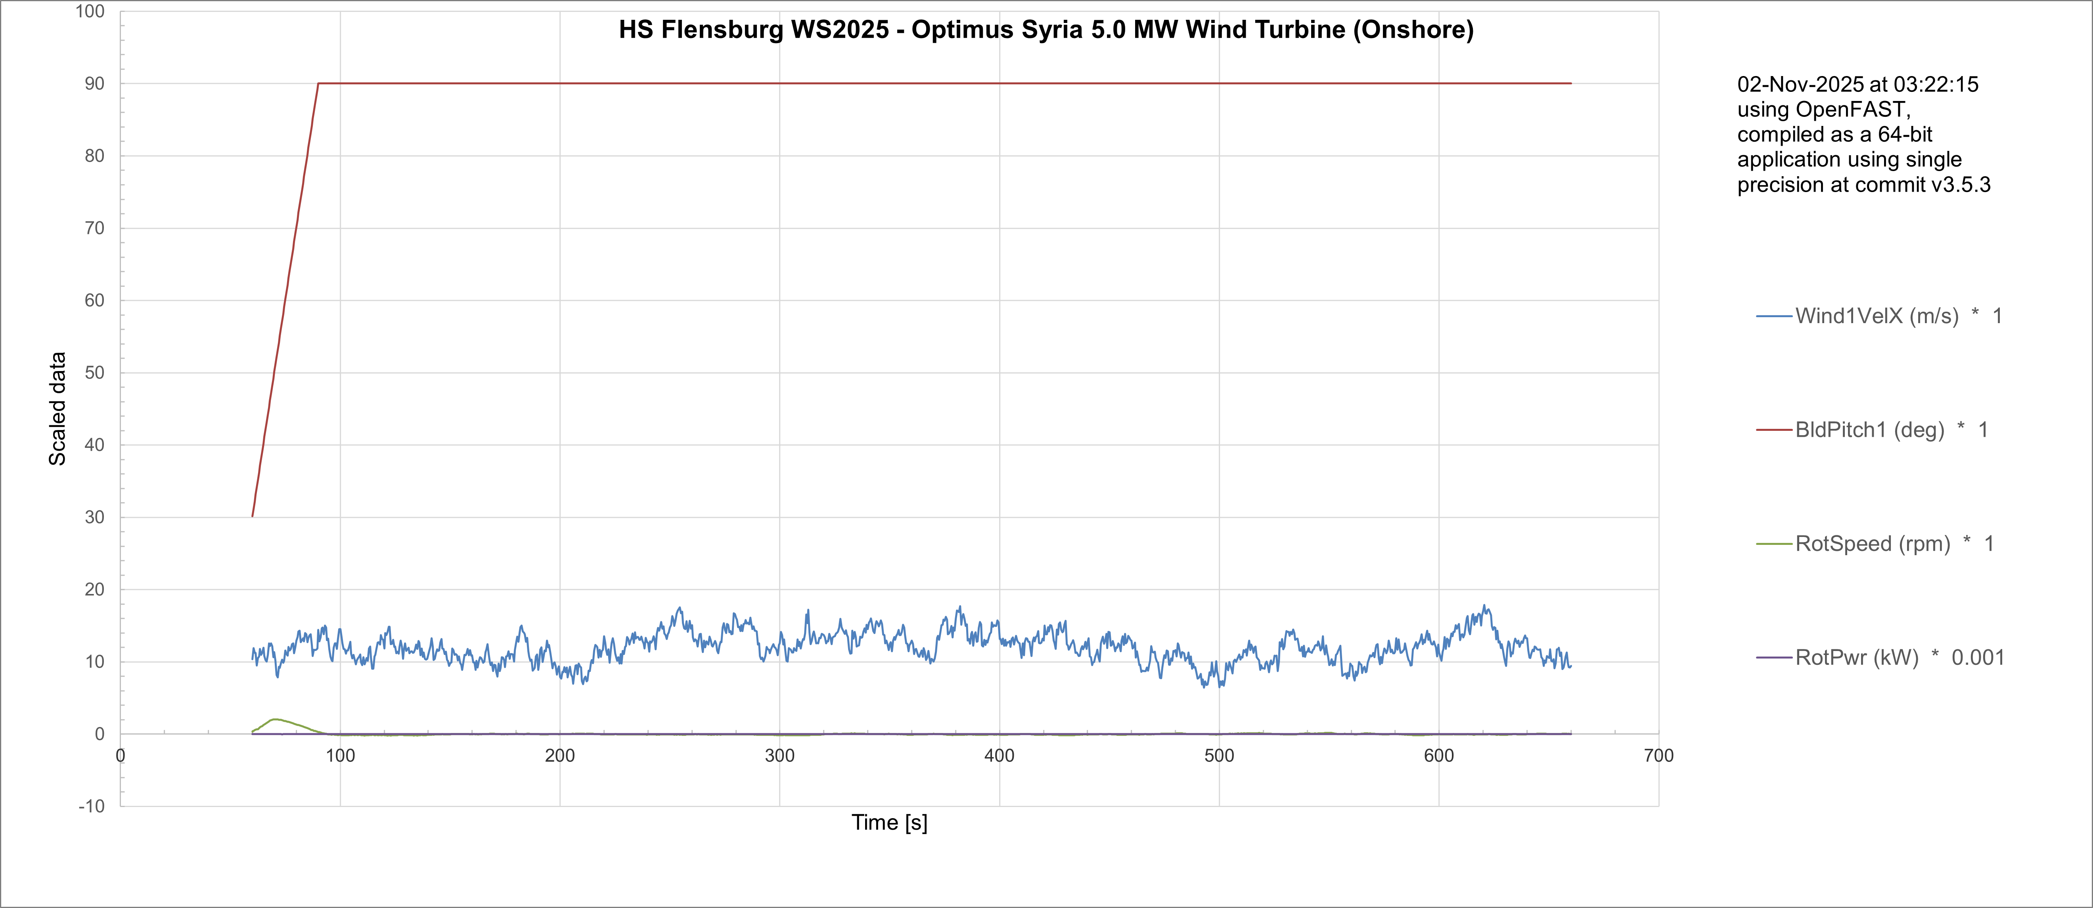
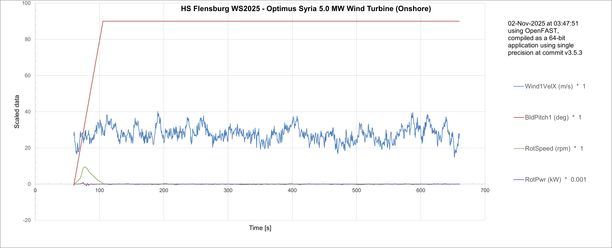
Simulation for DLC 5.1
12m/s
28m/s
04/11/2025
Md Aman
Load & Dynamics Team/ Optimus Syria

Slide 43
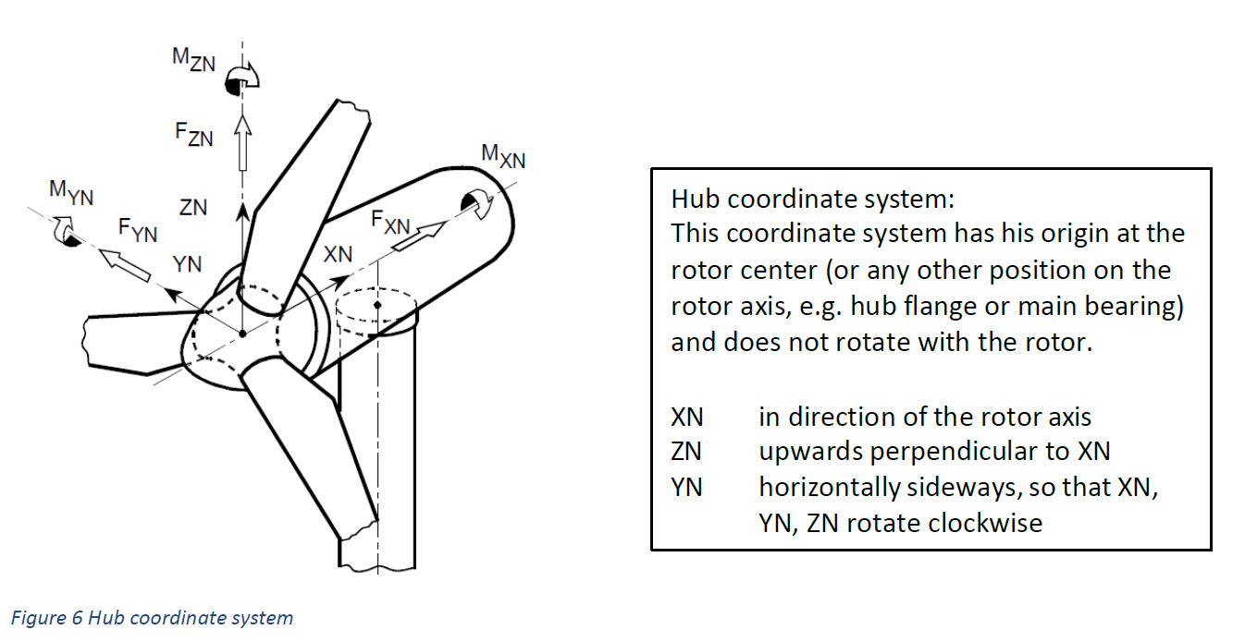
Conclusion & Future Plan
The hub coordinate system is used because it stays fixed with the nacelle, making rotor loads easy to interpret, sum, and transfer to the drivetrain and control systems — without the complication of rotating coordinates.
In the last week we
Configured Wind Simulations for NTM with different wind speeds
Configured Simulation with DLC 5.1
Understand use of MExtremes
Provided forces and moments at different section of turbine to other teams
In the next week
More simulations with DLC 5.1
Simulate OpenFAST for updated parameter of turbine
Configure Simulation with other DLC Cases
Work with different groups
Start Calculation of MExtremes
04/11/2025
43
Md Aman
Load & Dynamics Team/ Optimus Syria

Slide 44
References
Load Reports of the OPTIMUS projects
GL Guideline for the Certification of Wind Turbines Edition 2010
Loads and site conditions for wind turbines, DNVGL-ST-437,Edition November 2016
IEC 61400-1 2019-02, Ed. 4.0/ DNVGL-ST-0437 Loads and site conditions for wind turbines 11-2016
TurbSim, OpenFAST & NREL 5 MW
04/11/2025
44
Arham Memon
Load & Dynamics Team/ Optimus Syria

Slide 45
Weekly report: Feedback Controller
Week number: 06
Date: 04/11/2025
Supervisor: Prof. Dr.-Ing. David Schlipf
Group members: Mirza Dincer, Saurabh Pankaj Jha, Midhun Kanichattu Venu
Presenter: Saurabh Pankaj Jha

Slide 46
List of Contents
Tasks of the Week
Kp and Ki optimization method over DLC 1.2
Signal Chain in Lidar – Assisted Controller
Conclusion
Mirza Dincer - 780261

Slide 47
Tasks of the Week
Optimization method for Kp and Ki for ROSCO input.
Understanding signal chain for Signal Chain in Lidar – Assisted Controller
Mirza Dincer - 780261

Slide 48
Kp and Ki Optimization Method
Kp, Ki and theta is a vector with a 30 number of elements in ROSCO input file.
It is time consuming to calculate Kp and Ki for each theta angle. Instead, an optimization method is used.
Ti will be kept constant to 1P time.
Start by choosing a starting point of Kp and theta, and neighbour points. Then convert this points to a vector for ROSCO input file and run DLC 1.2 simulation.
As a result, We will have a map with each point we selected with DEL and AEP, will search for the point where minimum DEL of tower base fore-aft bending moment and the AEP is maximum.
Mirza Dincer - 780261

Slide 49
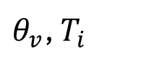
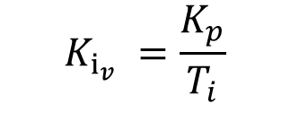
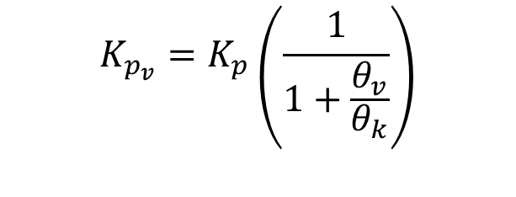
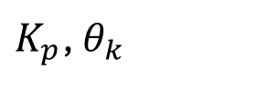
Kp and Ki Optimization Method
$θ_{v}$, $T_{i}$
$$K_{p_{v}}=K_{p}\left(\frac{1}{1+\frac{θ_{v}}{θ_{k}}}\right)$$
$K_{p}$, $θ_{k}$
Mapping
$$K_{i_{v}} =\frac{K_{p}}{T_{i}}$$
Mirza Dincer - 780261

Slide 50
DLC 1.2 Simulation Settings
660 seconds of simulation. Evaluation of values starts at t = 60 second to get settled values. Additionaly wind wraps around.
DLC 1.2 wind fields with average of 8 m/s to 24 m/s with steps with 4m/s, 3 seeds.
Enabled all DOFs.
Initial conditions of pitch angle, rotor speed and fore-aft tower position for every corresponding wind speed.
Running only feedback controller, no Lidar-assisted controller.
Mirza Dincer - 780261

Slide 51
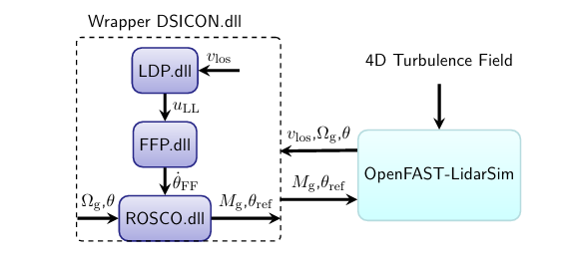
Signal Chain in Lidar – Assisted Controller
For the configuration of Lidar – Assisted Controller, wrapper dynamic library is used. Which runs the used DLLs in sequence.
Lidar Data Processing (LDP) DLL is used to estimate rotor effective wind speed (REWS).
Feedforward Pitch (FFP) DLL is used to provide feedforward pitch rate at correct time
The overall OpenFAST and LAC interface. [1]
[1], [2], [3]
Mirza Dincer - 780261

Slide 52
Signal Chain in Lidar – Assisted Controller
Lidar Line-of-Sight Wind Speed (vLOS) [m/s]
Lidar sensor measures wind velocity along its line-of-sight.
Represents wind conditions before reaching the rotor.
Preview Wind (uLL)
Derived from vLOS measurements through LDP.DLL.
Represents the predicted wind at the rotor disk.
Feedforward Pitch Rate (θ̇_FF) [rad/s]
Computed inside FFP.DLL based on preview wind uLL.
Defines how fast the blades should pitch in response to upcoming wind changes.
Pitch Command (θ_ref) [theta]
Final collective pitch command sent to blade actuators.
Combination of feedback (from speed error) and feedforward (from predicted wind).
[1], [2], [3]
Mirza Dincer - 780261

Slide 53
Conclusion
Script for optimization method will be ready for our Optimus turbine.
Understand signal chain in lidar and how it connects to ROSCO controller.
Next weeks:
Use optimization method for IEA 3.4 MW
How swap array works in Lidar – Assisted Controller
EOG gust simulations with Lidar – Assisted Controller
Mirza Dincer - 780261

Slide 54
Bibliography
[1] F. Guo, D. Schlipf, and Po Wen Cheng, “Evaluation of lidar-assisted wind turbine control under various turbulence characteristics,” Wind energy science, vol. 8, no. 2, pp. 149–171, Feb. 2023, doi: https://doi.org/10.5194/wes-8-149-2023.
[2] D. Schlipf, E. Simley, F. Lemmer, L. Pao, and P. W. Cheng, “Collective Pitch Feedforward Control of Floating Wind Turbines Using Lidar,” Journal of Ocean and Wind Energy, vol. 2, no. 4, Nov. 2015, doi: https://doi.org/10.17736/jowe.2015.arr04.
[3] F. Dunne, L. Y. Pao, A. D. Wright, B. Jonkman, and N. Kelley, “Adding feedforward blade pitch control to standard feedback controllers for load mitigation in wind turbines,” Mechatronics, vol. 21, no. 4, pp. 682–690, Apr. 2011, doi: https://doi.org/10.1016/j.mechatronics.2011.02.011.
Mirza Dincer - 780261

Slide 55
Weekly report: Rotor Blade Design
Week number: 06
Date: 04.11.2025
Supervisor: Prof. Dr. rer.nat. Alois Schaffarczyk
Team members: Harsh Panchal, Kandarp Pathak, Jay Pandya, Daniyal Sikander
04.11.2025
55
Harsh Panchal
Rotor Blade Design/ Optimus Syria

Slide 56
List of contents
Blade Geometry
Cp vs Tip Speed Ratio Graph
Power Graph
04.11.2025
Harsh Panchal
Rotor Blade Design / Optimus Syria

Slide 57
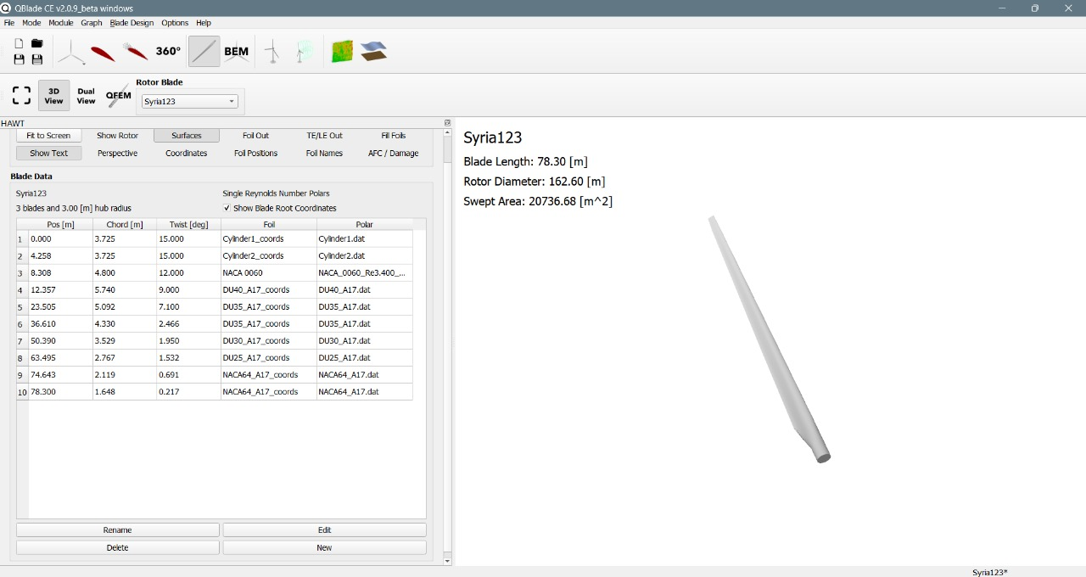
Blade Geometry
Source: Own Analysis MATLAB
04.11.2025
Harsh Panchal
Rotor Blade Design / Optimus Syria

Slide 58
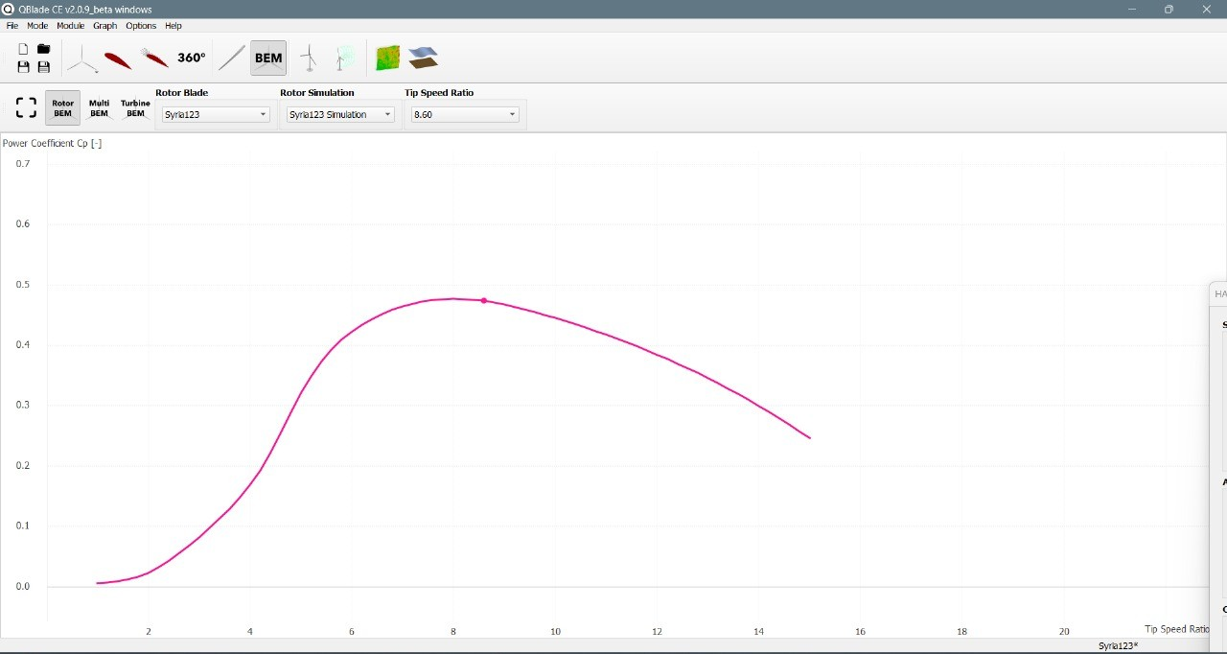
C_{p} vs Tip Speed Ratio Graph
Source: Own Analysis Q-blade
04.11.2025
Harsh Panchal
Rotor Blade Design / Optimus Syria

Slide 59
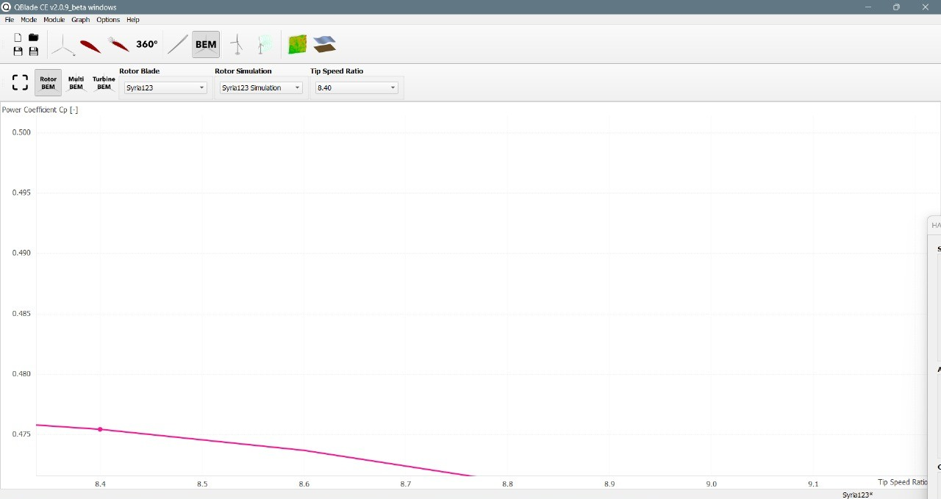
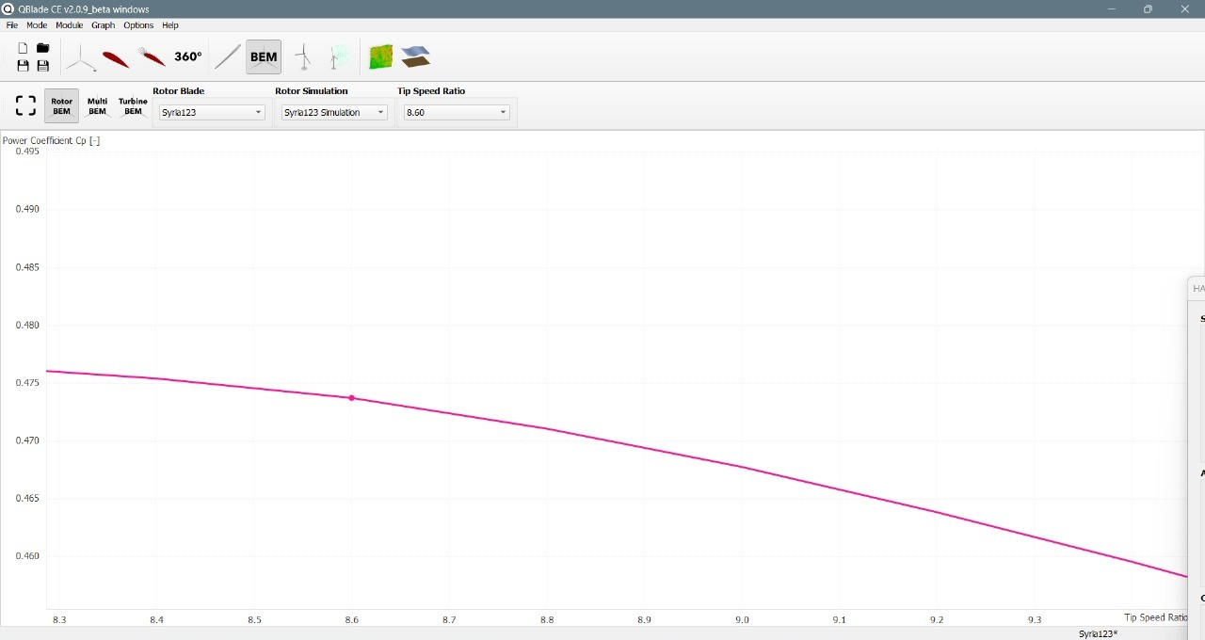
C_{p} vs Tip Speed Ratio Graph
Source: Own Analysis Q Blade
04.11.2025
Harsh Panchal
Rotor Blade Design / Optimus Syria

Slide 60
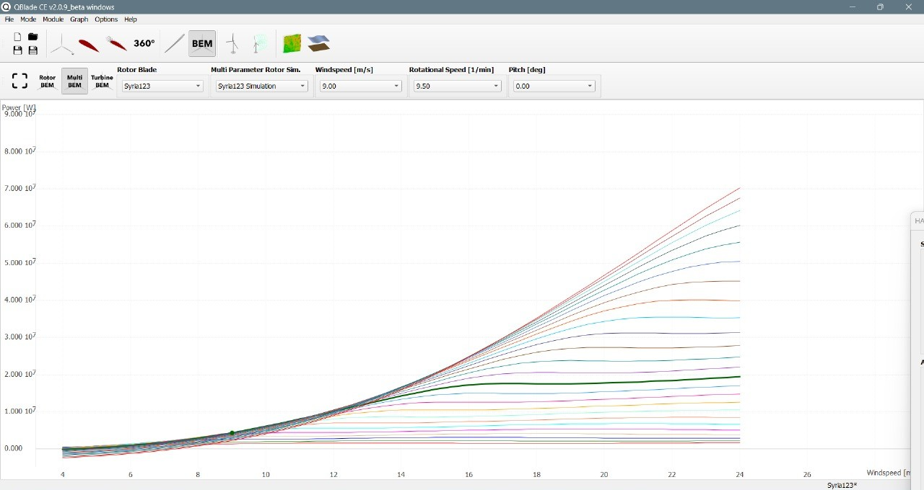
Power Graph
Source: Own Analysis Q Blade
04.11.2025
Harsh Panchal
Rotor Blade Design / Optimus Syria

Slide 61
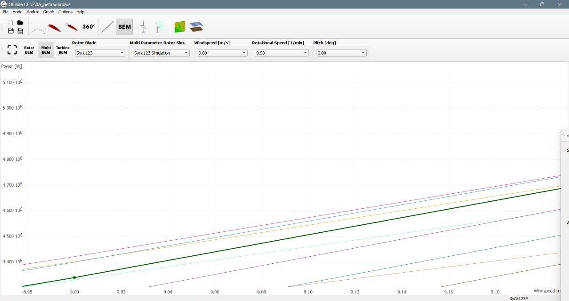
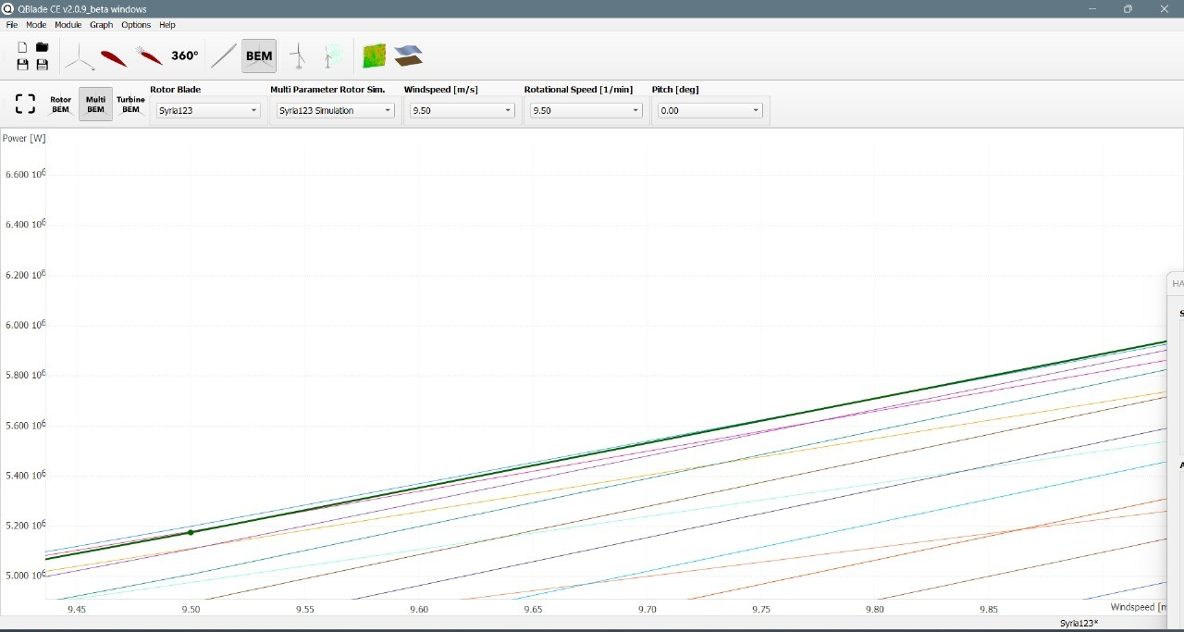
Power Graph
Source: Own Analysis Q Blade
04.11.2025
Harsh Panchal
Rotor Blade Design / Optimus Syria

Slide 62
Bibliography
Self Generated Content (01.11.2025)(20:00)
04.11.2025
Harsh Panchal
Rotor Blade Design / Optimus Syria

Slide 63
Team 5 – Rotor Blade Structures
Week No - 6
Date - 04.11.2025
Supervisor - Dr. Laurence Alhrshy
Presented by – Dongsuk Kim(770143)
Team Members - Bhima B Masare, Anudeep Allanki, Dongsuk Kim, Mithun Shetty

Slide 64
Contents
Rotor Blade Structures Team Time line
Team Responsibilities and Output Flow
Temporary Structural Design limits for 80m Blade
Material selection for 80m Blade
4.1 Design limit and comparison
4.2 Main Blade Materials and Cost
4.3 Cost Reduction Strategies
Bibliography
Dongsuk Kim

Slide 65
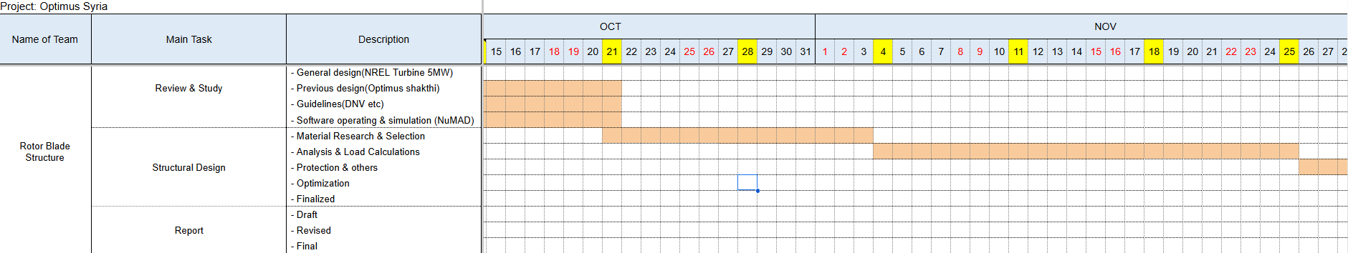
1. Rotor Blade Structures Team Time line
1.1 From Oct to Nov
Dongsuk Kim

Slide 66
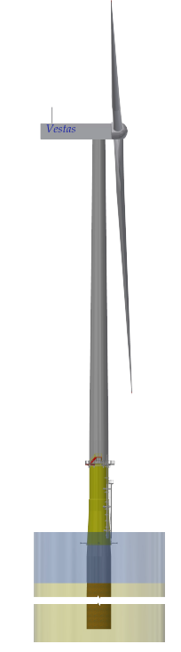
2. Tem responsibilities and Output Flow–
Output
Fixed
Airfoil sequence
Chord length(m)
Relative thickness(t/c)
Twist distribution(deg)
Design Tip Speed Ratio(TSR)
Power coefficient(cp)
Radial positions(m)
WTG 5MW
Rotor Blade Design Team
BEM
Fixed
Optimus
RD 160m
Yes
No
Fixed
Deflection, δ(r) / δ_tipChord
Spar Cap Thickness, t_spar(r)
Elastic Modulus, E_L
Mass Distribution
HH 120m
Rotor Blade Structure Team
EB Theory
Yes
No
Static Load Cases
Dynamic Load Cases, DLC
Natural Frequencies
Load & Dynamics Team
SLC,DLC
Dongsuk Kim

Slide 67
3. Temporary Structural Design limits for 80m Blade –
No. | Parameter | NREL 5 MW (61.5 m Blade) | Scaling (Calculation Method) | Optimus Syria 5MW (80 m Blade) | Remark
1. | Tip Deflection Limit (δ_tip,max) | 8 m (≈ 0.13 · R) | Proportional to Blade Length (R₈₀/R₆₁.₅ = 1.30) | ≈ 10 m (0.125 · R) | Structural limit for stiffness design
2. | First Aerodynamic Profile Location (r/R) | 0.08 – 0.10 | Non-dimensional (no scaling) | 0.10 (allowable 0.08 – 0.12) | 0 – 0.10 R = structural root (Non-dimensional ratio,)
3. | Maximum Chord (C(max)) | 4.65 m | Manufacturing / transport limited; not strictly ∝ R | ≤ 5.0 m (recommended 4.9–5.0 m) | 5 m is practical for mold and road transport width limits.
4. | Maximum Twist Angle (θ(max)) | ~14.5° | Manufacturing limit (mold and laminate lay-up complexity) | ≤ 18° (recommended 16–18°) | Twist > 20° causes tooling issues; limit gradient ≈ ≤ 2° per 5 % span.
5. | Blade Mass (per Blade) | ≈ 18 t @ 61.5 m | Mass ∝ (R₈₀/R₆₁.₅)³ = (1.30)³ ≈ 2.2 × m₆₁.₅ | ≈ 35 – 40 t | Weight scaling estimate
6. | Tip Clearance Guide | ≈ 4 m | Scaled by R ratio (×1.3) | ≥ 5 m | To avoid tower strike under load
7. | Manufacturing Guide for Spar Cap Thickness | t_tip ≥ 2 mm, t_root ≤ 60 mm | Scaled by R ratio (×1.3) | t_tip ≥ 3 mm, t_root ≤ 80 mm | Manufacturing envelope
8. | Estimated Spar Cap (h_cap) | h_cap ≈ 0.6 · (t/c) · chord | Empirical relation maintained | h_cap ≈ 0.6 · (t/c) · chord | To be confirmed after geometry fix
※ All scaled values are based on geometric similarity: geometry ∝ R, mass ∝ R³, loads ∝ R³, Keeping t_spar ∝ R maintains similar stress and deflection behavior so the new limits (e.g., δ_tip ≈ 10 m) are physically consistent with the NREL 5 MW reference
Dongsuk Kim

Slide 68
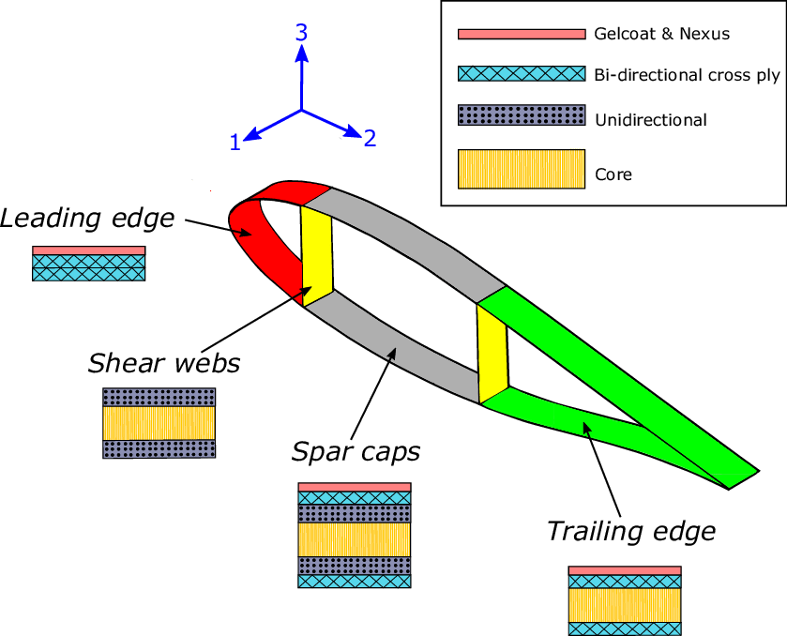
4. Material selection for 80m Blade–
4.1 Design limit and comparison –
Airfoil Structure | Blade Region | NREL 5 MW (61.5 m) | Optimus 5NW (80.0m) | Reason
 | Spar Cap | Hybrid Carbon + Glass UD (0°) | Full Carbon UD (0°) | - Higher bending moment. - Increase EI and reduce tip deflection & mass.
 | Shell (Suction/Pressure) | Glass Triax (±45/0/90) Lay-up: [±45 / 0 / 90 / ±45 / 0]ₛ | Glass Triax (±45 dominant) Lay-up: [±45 / 0 / ±45 / 90 / ±45 / 0 / ±45]ₛ | - More ±45° plies increase torsional stiffness (GJ) - shear resistance for longer, flexible blades.
 | Shear Webs | Glass ±45 + thin foam core Lay-up: [±45/G] + Core + [±45/G] | Glass ±45 + thicker foam core (50 → 80 mm) Lay-up: [±45/G] + Core(↑t) + [±45/G] | - Shear load ↑ → thicker core improves shear stiffness & buckling resistance.
 | Core (in Shell) | PVC / Balsa Foam (ρ ≈ 60 kg/m³) | High-density PVC or PET Foam (ρ ≈ 80–100 kg/m³) Thickness tapered along span | - Prevent shear failure & skin buckling under higher spanwise loads.
 | Trailing Edge (TE) | Glass + thin foam core Lay-up: [±45 / 0]ₛ + core | Glass + thicker foam + reinforcement patch Lay-up: [±45 / 0 / ±45]ₛ + core | Local buckling risk ↑; reinforced TE prevents opening, improves fatigue resistance.
 | Leading Edge (LE) | Glass + solid insert | Glass + Carbon Hybrid (optional) | - Improve impact, erosion resistance in longer blades.
 | Root Region | Thick Glass + Adhesive Joint | Glass + Carbon Hybrid (optional) | - Increase root strength and reduce weight for bolt interface.
Source: https://doi.org/10.1016/j.marstruc.2020.102858
Dongsuk Kim

Slide 69
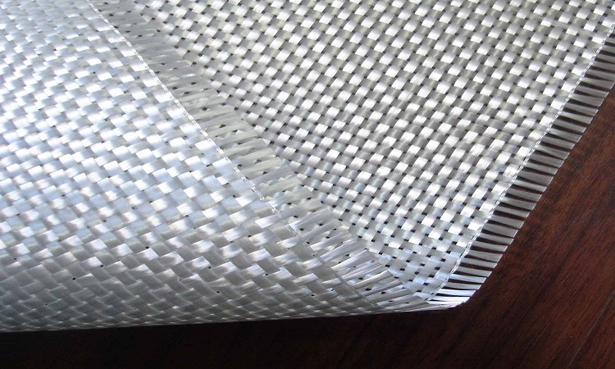
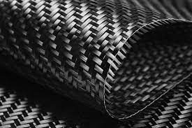
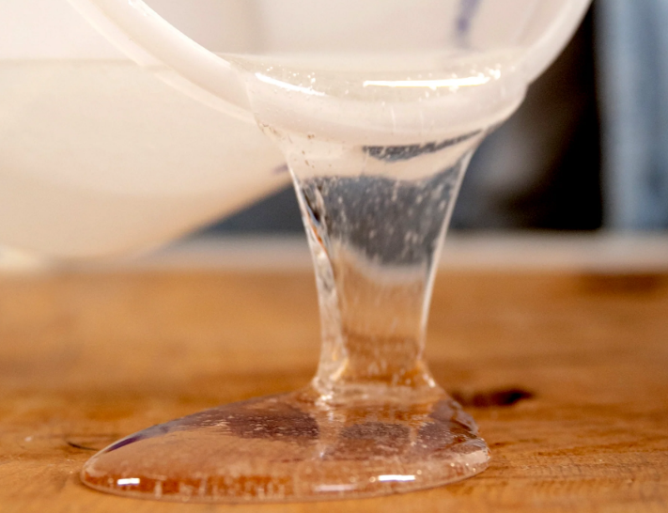
4. Material selection for 80m Blade –
4.2 Main Blade Materials and Cost –
Material | Main Features | Where Used | Unit Cost (€/kg) | Est. Weight of NREL5MW (kg) | Subtotal | Share
E-glass fiber | Strong, Low cost, Heavy | Shell skin, shear web, root reinforcements | 1.8 | ~13,000 | € 23,400 | 38%
Carbon fiber | High stiffness/strength, lightweight | Spar caps (load-carrying beam) | 25 | ~500 | € 12,500 | 20%
Epoxy resin | Excellent bonding, heat/chem. resistance | Matrix for all composites (fiber wet-out) | 4 | ~5,000 | € 20,000 | 33%
Core (PET/PVC/Balsa) | Lightweight sandwich material | Shell and shear web core panels | 4 | ~1,200 | € 4,800 | 8%
Adhesive & gel coat | Bonding, sealing, surface finish | Bond lines, LE/TE joints, outer surface | 10 | ~100 | € 1,000 | 1%
Total Material Cost (55%) |  |  |  | 19,800 | ≈ € 61,700 | 100%
+ Manufacturing (35%) |  |  |  |  | ≈ € 39,200
+ Quality & Process (10%) |  |  |  |  | ≈ € 11,200
= Total Production Cost (100%) |  |  |  |  | ≈ € 112,000 / blade
E-glass fiber
Carbon fiber
Epoxy resin
Source: Wind Turbine Reliability: A Database and Analysis Approach
Dongsuk Kim

Slide 70
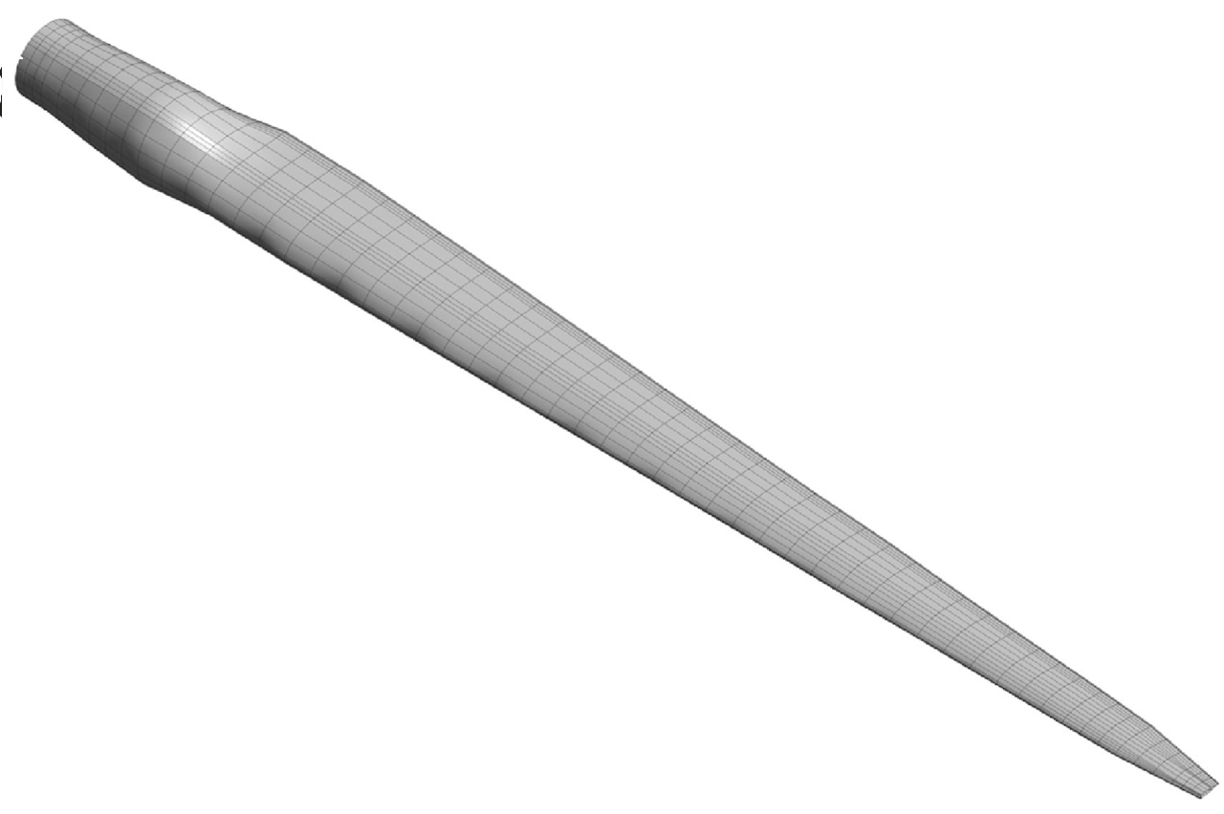
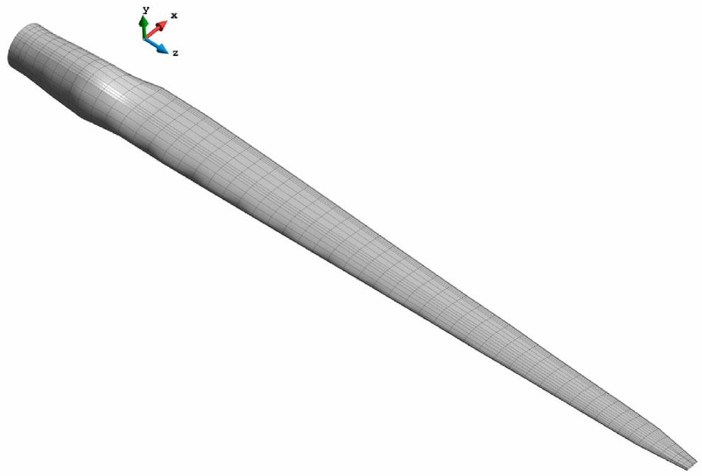
4. Material selection for 80m Blade –
4.3 Cost Reduction Strategies –
Ⅰ. Material Optimization
- Less Carbon ↓
- More Glass ↑
- Replace PVC↔PET
Ⅱ. Geometric Simplification
- Reduce number of unique molds
Ⅲ. Manufacturing Process Efficiency
- High-speed infusion
- 3D Printing Automation
- Reuse of existing molds/platforms
€ 112,000 * (1.3)³ =
Max € 246,000
€ 246,000 * 3 ea =
Min € 600,000 ~ Max € 738,000
Dongsuk Kim

Slide 71
Bibliography
Definition of a 5 MW/61.5m Wind Turbine Blade Reference Model by Brian R. Resor, Sandia National Laboratories, California, USA
Definition of a 5 MW Reference Wind Turbine for Offshore System Development, J. Jonkman, S. Butterfield, W. Musial, and G. Scott, National Renewable Energy Laboratory, USA
Reports from Optimus Shakthi 2024
Lecture Scripts from Prof. Dr. Francesco Previtali
Lecture Scripts from Prof. Dr. Laurence Alhrshy
Structural analysis of an offshore vertical axis wind turbine composite blade experiencing an extreme wind load,Brian P, Hand, university College Cork, 09. 2020
Sandia National Laboratories Wind Turbine Blade Manufacturing Cost Studies (SAND2006-1100)
Dongsuk Kim

Slide 72
Weekly report: Electrical Drivetrain
Week number: 6
Date: 04/11/2025
Supervisor: Prof. Dr.-Ing. Saiju
Group members: Aiswarya Vijayan, Vishranti Shivajirao Patil , Girish Mahadeo Padalkar, Cristina Milene Vergara Hernandez

Slide 73
List of contents
Converter Size and Configuration
IGBT Module Structure
IGBT Configuration
How IGBT is connected
Control Structure Overview
Control structure of Converter
Component Dimensions & Parameters
Next steps
Aiswarya Vijayan
Electrical Drive Train/ Optimus Syria

Slide 74

1.Converter Size and Configuration
Type: 2-Level Back-to-Back Voltage Source Converter (VSC)
• Power rating: ~25% - 30% of 5 MW → ≈1.25 - 1.5 MW
• DC-link voltage ≈ 1.2 kV
• Converter cabinet: ~1.8×1.0×2.0 m, ~2 tons each side
• Components: Rotor-Side Converter (RSC), Grid-Side Converter (GSC), DC-link capacitors
Source: https://www.researchgate.net/publication/263364715_Electrical_machines_and_power-electronic_systems_for_high-power_wind_energy_generation_applications_Part_II_-_Power_electronics_and_control_systems
Electrical Drive Train/ Optimus Syria

Slide 75

2. IGBT Module Structure
Each converter leg uses 2 IGBTs per phase, often paralleled for current rating
• Gate-driver boards mounted close to IGBTs to minimize inductance
• Liquid cooling manifold distributes coolant through all modules
• Compact cabinet includes filter inductors, DC-link capacitors, and control boards
Aiswarya Vijayan
Electrical Drive Train/ Optimus Syria

Slide 76

3. IGBT Configuration
Converter Device Configuration
2-level, 3-phase bridge per converter (RSC & GSC)
Each phase leg = 2 IGBTs (upper & lower) + anti-parallel diodes
3 legs × 2 IGBTs = 6 IGBTs per converter
RSC + GSC → 12 IGBTs total
Parallel Module Sizing
Converter power = 1.25 MW, V = 690 V LL
Phase current ≈ P / (√3 × V) = 1 046 A RMS
Module rating = 1 200 A @ 1 700 V → derated to
0.85 × 1 200 = 1 020 A
Required parallels = 2 modules per leg
6 half-bridge modules per converter (3 legs × 2 parallel)
12 modules total for back-to-back converter
https://www.researchgate.net/publication/224697059_Optimized_Direct_Power_Control_Strategy_using_Output_Regulation_Subspaces_and_Pulse_Width_Modulation
Aiswarya Vijayan
Electrical Drive Train/ Optimus Syria

Slide 77

3. How IGBT is connected
Each converter (RSC or GSC) has:
Three phase legs (A, B, C)
Each leg: Two IGBTs connected in series is connected through a DC-link capacitor.
RSC controls rotor current (torque + reactive power).
GSC controls DC-link & grid reactive power.
Aiswarya Vijayan
Electrical Drive Train/ Optimus Syria

Slide 78

4. Control Structure Overview
DFIG uses two converters:
1. Rotor-Side Converter (RSC) – controls torque and reactive power
2. Grid-Side Converter (GSC) – maintains DC-link voltage and power factor
• Control performed in dq synchronous reference frame using vector control
• Communication between RSC and GSC through DC-link voltage feedback
Source : https://www.ingeteam.com/us/en-us/power-electronics/wind-power-energy
Aiswarya Vijayan
Electrical Drive Train/ Optimus Syria

Slide 79

5. Control structure of Converter
Electrical Drive Train/ Optimus Syria

Slide 80

6. Component Dimensions & Parameters
Parameter | Symbol | Typical value | Description
Rated converter power | $$P_{c}$$ | 1.25 MW | 25 % of 5 MW
Rated DC link voltage | $$V_{dc}$$ | 1200 V | Intermediate link voltage
Converter current | Ic​ | ≈ 1060 A | At 1.25 MW, 1200 V
DC link capacitance | $$\text{Cdc}\text{​}$$ | ≈ 0.107 F | For ΔV = 5 %
IGBTs per converter | $$−$$ | 6 | Two per phase
Cooling | $−$ | Liquid or forced air | Required for continuous operation
Mounting | $$−$$ | Inverter cabinet (≈ 1.6 x 0.8x 0.6 m ) | Installed in nacelle
Total converter mass | $$−$$ | ≈ 2 tonnes | Including heatsinks,busbars, filter
Aiswarya Vijayan
Electrical Drive Train/ Optimus Syria

Slide 81
7.Next Step
Finalize all the Electrical parameters.
Finalize the size of each components.
Develop the complete DFIG drivetrain model in MATLAB/Simulink.
Aiswarya Vijayan

Slide 82

Bibliography
Z. Q. Zhu and J. Hu, “Electrical machines and power-electronic systems for high-power wind energy generation applications: Part II – power electronics and control systems,” COMPEL: The International Journal for Computation and Mathematics in Electrical and Electronic Engineering, vol. 32, no. 1, pp. 34-71, 2013, doi: 10.1108/03321641311293740.(accessed on 31/10/2025)
Hussain, H. A., Loncarski, J., Ristic, L. B., & Bellini, A., “DFIG-Based WECS With Partial-Scale Converter: Efficiency, Cost, and Volume Comparison of SiC-Based and IGBT-Based Converter Solution,” IEEE Access, vol. 12, pp. 89908-89920, 2024, doi: 10.1109/ACCESS.2024.3419810.(accessed on 30/10/2025)
Shabani, H. R., Hajizadeh, A., Kalantar, M., et al., “Transient stability analysis of DFIG-based wind farm-integrated power system considering gearbox ratio and reactive power control,” Electrical Engineering, vol. 105, pp. 3719-3735, Dec. 2023, doi: 10.1007/s00202-023-01906-3.(accessed on 01/11/2025)
El Moudden, A., Aarib, A., & Hmidat, A., “The Converter Command for the Doubly-Fed Induction Generator with Variable Speed used in the Wind Power Production,” International Journal of Applied Information Systems, vol. 8, no. 6, pp. 32-39, Apr. 2015, doi: 10.5120/ijais15-451335.(accessed on 31/10/2025)
F. Shafiei, “Modelling and Verification of Doubly Fed Induction Generator (DFIG) using Real Time Digital Simulator (RTDS),” Master’s thesis, Chalmers University of Technology, Göteborg, Sweden, 2012. [Online]. Available: https://publications.lib.chalmers.se/records/fulltext/169777/169777.pdf (accessed on 02/11/2025)
ABB, “ACS880-17 Cabinet-Built Single Drives Technical Catalog,” ABB Oy, Helsinki, Finland, 2023. [Online]. Available: https://new.abb.com/drives (accessed on 01/11/2025)
Semikron Danfoss, “SKiiP Intelligent Power Modules – Product Family Overview,” Nuremberg, Germany, 2023. [Online]. Available: https://www.semikron-danfoss.com (accessed on 01/11/2025)
TDK Electronics, “B25667 Series: Power Capacitors for DC-Link Circuits (MKP Technology),” Datasheet, 2024. [Online]. Available: https://product.tdk.com/en/catalog (accessed on 02/11/2025)
11/04/2025
Aiswarya Vijayan
9

Slide 83
Weekly report: Grid Code Development
Week number: 6
Date: 4/11/2025
Supervisor: Prof. Ing. Saiju
Presented by: Josef Remberger / Vijay Simha Reddy Bogala

Slide 84
List of contents
Milestones
State of the art Grid Code
Basic Data
Fault Ride Through (FRT)
Droop Characteristics
Advices for changing Grid Code
PowerFactory
Josef Remberger

Slide 85

1. Milestones
Josef Remberger

Slide 86
2-i. Basic Data
Operation state | Frequency [Hz] | Voltage [kV]
Normal | 49.90 – 50.10 | 59.5 – 72.5 / 207 – 241.5
System stress | 48.75 – 51.25 | 59.5 – 72.5 / 207 – 241.5
Emergency / extreme fault | 47.5 ≤ X ≥ 51.5 Hz | 59.5 < X > 72.5 / 207.0 < X > 241.5
Restorative / black start | - | -
[1]
Josef Remberger

Slide 87

2-ii. Fault Ride Through (FRT)
Low voltage ride through behaviour (LVRT)
High voltage ride through behaviour (HVRT)
Not mentioned !
Voltage Profile Recovery of Wind Generators During and After a voltage sag; [1] PETE; (01/11/2025)
[1]
Josef Remberger

Slide 88

2-iii. Droop Characteristics
Reactive Power / voltage control
Active Power/ frequency control
Not mentioned !
Minimum requirements for a non-synchronous machine in
voltage control; [1] PETE; (01/11/2025)
[1]
Josef Remberger

Slide 89

3. Advices for changing Grid Code
LVRT
Change from 80% sag to 100% for 150 ms
-> Improvement of grid stability
[1], [2]
Improved low voltage ride through behaviour; [1],[2] PETE and VDE-AR-N 4110:2017-02; (01/11/2025)
Josef Remberger

Slide 90

3. Advices for changing Grid Code
HVRT
According to VDE-AR-N 4110:2017-02
Staying connected during surges
-> Improvement of grid stability
[2]
High voltage ride through behaviour according to VDE-AR-N 4110:2017-02; [2]; (01/11/2025)
Josef Remberger

Slide 91

3. Advices for changing Grid Code
Reactive power / voltage control
Staying with the current code
-> due to high voltage fluctuations in the
grid
Minimum requirements for a non-synchronous machine in voltage control; [1] PETE; (01/11/2025)
[1]
Josef Remberger

Slide 92

3. Advices for changing Grid Code
Active power / frequency
Normal operation f = 49.8 – 50.2 Hz
$∆P=20 P_{N}\frac{50.2 Hz −f_{grid}}{50 Hz}$ for 50.2 Hz < $f_{grid }$< 51.5 Hz
[3]
Josef Remberger

Slide 93

4. PowerFactory
Load Flow Calculation
WT: P = 5MW
Busbar: 0.96kV
Transformer: 0.96/20kV
Busbar: 20kV
Cable: NA2XS(F)2Y 1x120RM 12/20kV; 2.6 km
Busbar: 20kV
Transformer: 20/230kV
External Grid
Josef Remberger

Slide 94
Bibliography – Grid Code Development
[1] SYRRIAN ARAB REPUBLIC / Ministry of Electricity / PETE / Transmission Grid Code, 2014 (accessed Nov. 1, 2025)
[2] “Summary of the draft VDE-AR-N 4110:2017-02” VDE, 2017. https://eepublicdownloads.entsoe.eu/clean-documents/cnc-active-library/Germany/summary-draft-4110-en.pdf (accessed Nov.1, 2025)
[3] “Windkraftanlagen - Systemauslegung, Netzintegration und Regelung”, S.Heier 2022. (accessed Nov.1, 2025)
Josef Remberger

Slide 95
Rotor Hub And Pitch System
Group Members :
Dhruvin Kakdiya
Adharsh Pappinisseri Veedu
Muthu Thirunavukarasu
Syed Mohammed Sikandar
Week number : 06
Date: 04/11/2025
Supervisor: Prof. Peter Quell

Slide 96
List of contents
Hub Design
Adharsh Pappinisseri Veedu

Slide 97

Hub Design
Hub diameter: 4.5 meter
Spinner ring connection
Front view: Own hub design
Adharsh Pappinisseri Veedu

Slide 98

Shaft connection
Man holes
Back view
Adharsh Pappinisseri Veedu

Slide 99

Cone angle : 4’
Bearing inner ring connection
Top view
Adharsh Pappinisseri Veedu

Slide 100
Bibliography
Optimus ocean design
Optimus shakti design
Adharsh Pappinisseri Veedu

Slide 101
Weekly Presentation : Rotor Bearing System
Week number: 06
Date: 04/11/2025
Supervisor: Prof. Peter Quell
Group members: Divyesh Mistry, Venkata Sreekanth .K , Sreehari Padachery, Jill Sadariya
Presenter : Venkata Sreekanth .K
Venkata Sreekanth K.

Slide 102
Agenda
Task of the week.
Scaling : SKF Spherical Roller Bearing (Cylindrical Bore)
Load Equilibrium in a 3-Point Suspension System.
Reference : SKF Spherical Roller Bearing (Cylindrical Bore).
Bolted Flange Connection between Rotor Shaft and Rotor Hub.
Bibliography.
Venkata Sreekanth K.
Rotor Bearing team / Optimus Syria

Slide 103
Task of the week
Scaling of Spherical roller Bearing.
Scaling of Bearing Housing.
Torque wrench Selection & calculation.
Studied the flanges at rotor hub & Gear box. Conducted a meeting with System Integrator and Gear box team regarding the Flanges ( Not added in the PPT).
Venkata Sreekanth K.
Rotor Bearing team / Optimus Syria

Slide 104

Spherical roller bearing (Cylindrical Bore)
Scaling
240/1600 CAF/W33
240/1120 CAF/W33
Source: SKF
Venkata Sreekanth K.
Rotor Bearing team / Optimus Syria

Slide 105

Scaling : SKF Spherical Roller Bearing (Cylindrical Bore)
Bearing Basic Dimensions
Parameter | Symbol | Original (240/1120) | Scaled × 1.4286 (1600 bore)
Bore diameter | d | 1120 mm | 1600 mm
Outer diameter | D | 1580 mm | 2257 mm
Total width | B | 462 mm | 660 mm
Pitch circle diameter | PCD | 1388 mm | 1983 mm
Roller Arrangement Geometry
Parameter | Symbol | Original (240/1120) | Scaled × 1.4286 (1600 bore) | Remarks
Rollers per row (variant A/B) | n | 32 / 65 | 32 / 65 | 2 rows → 64 or 130 total
Angular spacing | θ | 11.25° / 5.538° | same | Angles don’t scale
Chord (center–center) | c ≈ | 136 mm / 67 mm | 194 mm / 96 mm | Linear × 1.4286
Arc distance (along PCD) | s = π·PCD/n ≈ | 136.3 mm / 67.1 mm | 194.7 mm / 95.8 mm | ≈ c for large PCD
Source: SKF
Venkata Sreekanth K.
Rotor Bearing team / Optimus Syria

Slide 106





chord-length formula
Symbol |  | Units
c | Straight-line distance between adjacent roller centers (the chord) | mm
θ | Angular spacing between those rollers, (360°/n) | degrees
R | Radius of the circle through the roller centers | mm
PCD | (2R) — the diameter of that circle | mm
Pitch-circle diameter (PCD)
PCD=2R,
240/1120 CAF/W33
Source: SKF
Arc distance (s) = the distance along the circular path (the pitch circle) between the centers of two adjacent rollers
Venkata Sreekanth K.
Rotor Bearing team / Optimus Syria

Slide 107
Roller & Cage Core Dimensions
Parameter | Symbol | Original (240/1120) | Scaled × 1.4286 (1600 bore) | Notes
Roller diameter | Dᵣ≈ | 100 mm | 143 mm | Linear scale
Roller length | Lᵣ≈ | 186 mm | 266 mm | Corrected length scaled
Cage inner Ø | ≈ | 1220 mm | 1743 mm | Inner-ring guided
Cage outer Ø | ≈ | 1480 mm | 2114 mm | Between raceways
Lubrication & Material
Parameter | Symbol / Meaning | Original (240/1120) | Scaled × 1.4286 (1600 bore) | Notes
W33 groove width |  | 12 mm | 17 mm | Lubrication groove
W33 groove depth |  | 5 mm | 7 mm | Lubrication groove
Materials |  | Bearing steel / brass (CA) | Same | Design unchanged
Venkata Sreekanth K.
Rotor Bearing team / Optimus Syria

Slide 108


Scaling : Bearing Housing
Case-1
SAF 240 Split plummer (pillow) block housing without bearing
Outer Diamter of bearing Housing :360mm
Bearing Seat width : 107.798mm
Total Length of bearing Housing : 749.3mm
Total width of bearing Housing : 285.75mm
Scaling factor :
Total Length of bearing housing for Syria =(2257mm/360mm) * 749.30mm
= 4697 mm
Total width of bearin Housing for Syria =
=(660mm/107.798mm)*285.75 mm
=1750mm
Source: SKF
Venkata Sreekanth K.
Rotor Bearing team / Optimus Syria

Slide 109

Case-2
Scaling based on Optimus 60E
Outer Diamter of bearing Housing :650mm
Bearing Seat width : 212mm
Total width of bearing Housing : 270mm
Width of Legs:450mm
Total Length of bearing Housing : 1250mm
Scaling factor :
Total Length of bearing housing for Syria =(2257mm/650mm) * 1250mm
= 4340 mm
Total width of bearin Housing for Syria =
=(270mm/212mm)*660 mm
=1400mm
Source: Optimus 60E
Case-3
Purely based on our assumption we take Total length of housing as 3057mm which is within tower top diamer (3800mm) .
Total width of housing around 1400mm
T
Venkata Sreekanth K.
Rotor Bearing team / Optimus Syria

Slide 110


Battery Torqure wrench for M39 bolts
Description | Value
Diameter of the socket at hexagonal head side of the Bolt (C) | 102 mm
Diameter of the socket at Anvil of (A) | 84 mm
Source: ENERPAC
Venkata Sreekanth K.
Rotor Bearing team / Optimus Syria

Slide 111




ISO 898-1:2013
 |  | Grade 10.9
Ultimate tensile strength | R_{m} | 1000 MPa
Yield strength | R_{e} | 900MPa
Proof load stress | S_{p} | 830MPa
R_{e} /R_{m} =0.9
A_{s}=
$\frac{π}{4}$(${d−0.9382P)}^{2}$
$=\frac{π}{4}$(${39−0.9382∗4)}^{2}$
= 975.8 mm²
F=0.7* R_{e} ​* A_{s} (Assumption ,preload force ≈ 70% of yield strength
$F=0.7×900 \text{MPa}×\text{975.8} {\text{mm}}^{2}=$
$F=\text{614754}\text{N}≈\text{614.754}\text{kN}$
Tightening torque T=K×F×d =0.25*614.754*.039
= 5.993 KNm
K = nut factor (depends on lubrication , Assuming dry k=0.25)
d = nominal diameter (m)
Source: ISO 898-1:2013
Venkata Sreekanth K.
Rotor Bearing team / Optimus Syria

Slide 112
Bibliography – Rotor Bearing System
SKF. (n.d.). SAF 240 - Bearing housings. Retrieved October 30, 2025, from https://www.skf.com/group/products/mounted-bearings/bearing-housings/split-pillow-blocks-saf-saw-series/productid-SAF 240
SKF. (n.d.). 240/1120 CAF/W33 - Spherical roller bearings. Retrieved October 29, 2025, from https://www.skf.com/group/products/rolling-bearings/roller-bearings/spherical-roller-bearings/productid-240%2F1120 CAF%2FW33
Optimus Shakti, Optimus 60E
Enerpac. (n.d.). BTW-Series: Battery torque wrench, square drive. Retrieved October 31, 2025, from https://www.enerpac.com/en-us/btw-series-battery-torque-wrench.
International Organization for Standardization (ISO). (2013). ISO 898-1:2013 – Mechanical properties of fasteners made of carbon steel and alloy steel – Part 1: Bolts, screws and studs with specified property classes — Coarse thread and fine pitch thread. Retrieved October 31, 2025, from https://standards.iteh.ai/catalog/standards/sist/3f0eaf9a-816b-4af7-8947-0bf298edf1ec/iso-898-1-2013
Venkata Sreekanth K.
Rotor Bearing team / Optimus Syria

Slide 113



Weekly report: Team Gearbox, Brake, Coupling
Week number : 06
Date: 04/11/2025
Supervisor: Prof. Peter Quell
Group Members :Nehang Jitendra Joshi,Santo Mazumder,Md Razaul Karim Rahat
Presented by -Md Razaul Karim Rahat
04-11-2025
Gearbox, Brake, Coupling

Slide 114
List of Content
1.Torque and rotational speed calculation
2.Topology of the gearbox
3.Dimension overview of the gearbox- Updated
4.Calculation of the 1st stage of planetary gear and 2nd stage also Spur gear stage calculation
5.Dimensioning of the brake Formula and Temperature check of brake disc
6.High Speed Side – Coupling Overview
04-11-2025
Gearbox, Brake, Coupling

Slide 115


Torque and rotational speed calculation
Initial condition - Vwind-11.92m/s ,Drotor-160m ,Prated-MW, u-85m/s , nhss-1200rpm
nGearbox- 0.94 % ngenrator- 0.97% ncoverter-0.96% ntransformer-0.99% ------Rotor side
ndrivetrain= ngear * ngen * ncov * ntran = 0.866
P rotor = Prated/ndrivetrain = 5MW/0.866 = 5.77 MW
W= 85 m/s *2/ 160 = 1.06 rad/s
M rotor = 5.77 MW / 1.06 rad/s =.5.44 MN.m
04-11-2025
Gearbox, Brake, Coupling

Slide 116


Torque and rotational speed calculation
Generator side
= w*60/2*3.14 = 10.12 rpm
I =nhss/nlss = 1200rpm / 10.12rpm = 118.57
Mgenerator=5.44MN.m / 118.57 = 0.045 MN.m
04-11-2025
Gearbox, Brake, Coupling

Slide 117


Topology of the gearbox
Reference: Lecture Notes by Prof. Peter Quell
Source: Own sketch
04-11-2025
Gearbox, Brake, Coupling

Slide 118

Dimension overview of the gearbox- Updated
Source: Own sketch
04-11-2025
Gearbox, Brake, Coupling

Slide 119
Dimension overview of the gearbox- Updated
Parameter | Dimensions in mm
Total Width of the gearbox | 2700 mm
Gearbox total diameter | 2100 mm
Half diameter of the gearbox | 1050 mm
Pin to pin distance from the center | 2400 mm
Gearbox center to pin center | 1200 mm
Bolt length near to elastomeric bearing | 0.525 mm
04-11-2025
Gearbox, Brake, Coupling

Slide 120
Formulas for Planetary gear
z_Ring | z_Sun +( 2 x z_Planet)
z_Planet | z_Sun + z_Ring
No. of Planets | 3
D_Sun | z_Sun x Module
D_Planets | (D_Ring /2) – (D_Sun/2)
D_Ring | z_Ring x Module
Gap | (D_Sun + D_Planets) * Pi / (No. of Planets) - D_Planets
Face Width | 10 x Module
Tooth Depth | 2.25 x Module
n_Ring | 0
n_Planet Carrier | 15
n_Sun | (1-i_1) x n_Planet Carrier
i_Sun,Planet | z_Planet / z_Sun
n_Planet | n_Sun / i_Sun,Planet
z = No. of Teeth
n = RPM
D = Pitch Circle Diameter
i = Gear Ratio
Reference: Lecture Notes by Prof. Peter Quell
04-11-2025
Gearbox, Brake, Coupling

Slide 121
Calculation of the 1st stage of planetary gear
I-1 ratio | 5.2
D_Planets (mm) | 672
Module mm | 16
z_Sun | 26
z_Ring | 110
z_Planet | 42
No. of Planets | 4
(z_Sun + z_Ring)/No. of Planets | 34
Tooth Depth | 36
D_Sun (mm) | 416
D_Ring (mm) | 1760
Gap (mm) | -672
Face Width | 160
n_Ring (rpm) | 0
n_Planet Carrier (rpm) | 15
n_Sun (rpm) | 78.4
i_Sun,Planet | 2
n_Planet (rpm) | -37.5
Reference: Lecture Notes by Prof. Peter Quell and PSGdesign book
04-11-2025
Gearbox, Brake, Coupling

Slide 122
Calculation of the 2nd stage of planetary gear
I-2 ratio | 4.7
D_Planets (mm) | 342
Module mm | 9
z_Sun | 28
z_Ring | 104
z_Planet | 38
No. of Planets | 3
(z_Sun + z_Ring)/No. of Planets | 44
Tooth Depth | 20.25
D_Sun (mm) | 252
D_Ring (mm) | 936
Gap (mm) | 280
Face Width | 90
n_Ring (rpm) | 0
n_Planet Carrier (rpm) | 78.4
n_Sun (rpm) | 369.8
i_Sun,Planet | 1.35
n_Planet (rpm) | 272.5
Reference: Lecture Notes by Prof. Peter Quell and PSGdesign book
04-11-2025
Gearbox, Brake, Coupling

Slide 123
Spur gear stage calculation
I-3 ratio | 4.8
Module mm | 9
Center distance mm | 585.8
No of teeth on pinion | 108
No.teeth on gear | 22
Width of the gear mm | 90
Hight factor mm | 1
Tooth depth mm | 20.25
Bottom clearance | 2.25
Dia of input shaft mm | 50
Dia of output shaft mm | 85
PCD of pinion | 972
PCD of gear | 198
Face width | 90
Input shaft rpm | 369.8
Output shaft rpm | 1200
Reference: Lecture Notes by Prof. Peter Quell and PSGdesign book
04-11-2025
Gearbox, Brake, Coupling

Slide 124

Dimensioning of the brake
Source: Prof. Quell’s Lecture Notes
04-11-2025
Gearbox, Brake, Coupling

Slide 125

Temperature check of brake disc
Source: Prof. Quell’s Lecture Notes
04-11-2025
Gearbox, Brake, Coupling

Slide 126

High Speed Side - Coupling
Features:
Wind power coupling
Backlash-free al-steel coupling / Laminae coupling
Laminas made of high-strength spring steel
Compensating for high displacements
Can be combined with our brake systems
Electrically insulating
With integrated torque limiter
RADEX-N for wind turbines
Source: https://www.ktr.com/en/products/radex-n-steel-lamina-couplings/radex-n-for-wind-turbines/
04-11-2025
Gearbox, Brake, Coupling

Slide 127
Bibliography
Gearbox
(1) Previous year Optimus projects 29-10-2025
(2) Roloff Matek Maschinenelemente 30-10-2025
(3) Lecture notes – Mechanical drive train by Prof.Peter Quell.29-10-2025
(4)Shigley's mechanical engineering design and PSG data book 30-10-2025
Brake
(1)Lecture Notes Mechanical Drivetrain 29-10-2025
(2)Previous year Optimus projects 30-10-2025
Coupling
(1)KTR Company website 01-11-2025
(2)Previous year Optimus projects 02-11-2025
04-11-2025
Gearbox, Brake, Coupling

Slide 128
Weekly report: Machine Bed & Yaw System
Week No - 6
Date: 04.11.2025
Supervisor: Prof. Peter Quell
Shoukat Abbas, Luksh Chawla, Sathishkumar Venkatachalam, Shrihari G Kadam
Presented by – Luksh Chawla

Slide 129
Contents
Number of Yaw Drives Calculation
Number of Yaw Drives – Syria
Yaw Bearing type
Machine Bed 2D sketching with proper Dimensions
References
Luksh Chawla

Slide 130
Number of Yaw Drives Calculation
Bonfiglioli 716 T4 drive (suggestion).
Assumptions:
Pitch circle diameter of yaw bearing PCD Bearing(Syria) =3800 𝑚𝑚
Nominal torque: 90 kNm
Pitch circle diameter of pinion PCD Pinion=288 𝑚𝑚
Operational yaw moment Mz,op(Syria)= 7164 kNm
Pinion module= 24
Pinion teeth number = PCDpin/Pinion module=288/24=12
Luksh Chawla

Slide 131

Number of Yaw Drives – Syria
Bearing teeth number =(PCDbearing)/ Bearing module =3800/24 = 158.33
rounded to 158.
The external gear ratio (iex) PCD Bearing = Bearing module × Bearing teeth number = 24 × 158 = 3792mm iex = PCDBearing /PCDPinion=3792/288 = 13.16
The number of yaw drives (N) is determined using the following formula: N=Total yaw moment/Each drive nominal torque × iex N =7164/90 × 13.16 = 6.04 rounded up to 6 no of yaw drives
Source: Bonfiglioli 716 T4F + BE160 + DGM Inverter [1]
Luksh Chawla

Slide 132

Yaw Bearing (Double-row 4-point Bearing)
Advantages –
Matches a larger tower-top geometry
High tilting moments for future load revisions
Sized for high loads
Conservative margin & system integration
Disadvantages –
Approximate and needs vendor verification
Higher cost/lead time and potential custom work
Upscaling by section modulus is approximate
Thyssenkrupp Double-row four-point yaw bearings (Series 09) [2]
Luksh Chawla

Slide 133
Double row 4 - Point Bearing (External Gearing)
Why does this choice fit Optimus Syria?
Tower-top diameter is 3.8 m (very close to Shakti’s final ~4.0 m PCD choice).
Similar interface and allows standard gear teeth dimensions/pinion geometry
Tilting moments are likely closer to Shakti’s loads
Double row four-point slewing bearing with external gearing (ThyssenKrupp style)
Sized close to the tower top / pitch-circle diameter (PCD)
Luksh Chawla

Slide 134

Bed Casting - 2D Dimension Defined
Note: For Defining of Dimension, we utilize Optimus 92LE Concept 2D drawing. [3]
Luksh Chawla

Slide 135
Bed Casting - Updation
1. Shaft Dimension - Looking for the proper dim. values of a shaft to fix the total length of the bed.
2. Yaw drives & Bearing - As per the calculation, we are going to use 6 yaw drives. Bed design update in progress.
3. Main Bearing and Gearbox Fixing Details Needed.
4. 3D Model on process - Reference Senvion MM92
Luksh Chawla

Slide 136
References
[1]. Bonfiglioli (accessed 19 Oct 2025). Solutions for Wind. https://www.bonfiglioli.com/_default_upload_bucket/TR_CAT_WIND_STD_ENG_R05_0.pdf
[2]. WEC Development Project: Optimus Shakti 5.0 Machine Bed and Yaw System Final Report.
[3]. Master Wind Engineering Project Optimus 92LE Machine Bed and Yaw System
Luksh Chawla

Slide 137
Weekly report: Tower structure
Week number: 06
Date: 04/11/2025
Supervisor: Prof. Faber
Group members: Ibrahim Mostafa, Mohammed Eldemerdash, Kirollos Ghaly
Speaker: Ibrahim Mostafa(770134)
03/11/2025
137
Group members: Ibrahim Mostafa, Mohammed Eldemerdash, Kirolls Ghaly
Tower structure team/ Optimus Syria

Slide 138
List of contents
Check local buckling analysis of the tower
03/11/2025
Group members: Ibrahim Mostafa, Mohammed Eldemerdash, Kirolls Ghaly
Tower structure team/ Optimus Syria

Slide 139

Check local buckling
Shell buckling (local buckling)according to EC3
$\frac{Nd}{2πRt}+\frac{Nel}{Nel−Nd}×\frac{Md}{πR^{2}t}$≤ $σ$cr
Given
Tower height H=100 m
Steel S355 → E=210 GPa=210,000 N/ ${mm}^{2}$, ν=0.30
Diameter D=4.8m⇒ R=2.4m
Design axial force Nd=9855kN
Design bending moment Md=284 000kn.m
03/11/2025
Group members: Ibrahim Mostafa, Mohammed Eldemerdash, Kirolls Ghaly
Tower structure team/ Optimus Syria

Slide 140

Check local buckling
03/11/2025
Group members: Ibrahim Mostafa, Mohammed Eldemerdash, Kirolls Ghaly
Tower structure team/ Optimus Syria

Slide 141

Check local buckling
03/11/2025
Group members: Ibrahim Mostafa, Mohammed Eldemerdash, Kirolls Ghaly
Tower structure team/ Optimus Syria

Slide 142

Check local buckling
03/11/2025
Group members: Ibrahim Mostafa, Mohammed Eldemerdash, Kirolls Ghaly
Tower structure team/ Optimus Syria

Slide 143

Check local buckling
03/11/2025
Group members: Ibrahim Mostafa, Mohammed Eldemerdash, Kirolls Ghaly
Tower structure team/ Optimus Syria

Slide 144

Check local buckling
03/11/2025
Group members: Ibrahim Mostafa, Mohammed Eldemerdash, Kirolls Ghaly
Tower structure team/ Optimus Syria

Slide 145

Check local buckling
7. Check Condition
$σN+σM=321.7 {\text{N}\text{/}\text{mm}}^{2}\text{<}322.7 {\text{N}\text{/}\text{mm}}^{2}$
✅ OK (safe)
03/11/2025
Group members: Ibrahim Mostafa, Mohammed Eldemerdash, Kirolls Ghaly
Tower structure team/ Optimus Syria

Slide 146

Sketch of tower dimensions
03/11/2025
Group members: Ibrahim Mostafa, Mohammed Eldemerdash, Kirolls Ghaly
Tower structure team/ Optimus Syria

Slide 147
Weekly report: Foundations
Week number: 07
Date: 04/14/2025
Supervisor: Prof. Dr.-Ing. Torsten Faber
Group members : Jehad Albaali- Amgad Gerges - Reda Deif
presented by : Amgad Gerges

Slide 148
List of contents
Reverification with detailed drawing
Concrete cover
Time Schedule Planning
Next tasks
Group members: Jehad Albaali- Amgad Gerges - Reda Deif
Foundations team/ Optimus Syria

Slide 149

Concrete Dimensions
Diameter of Base Plate (BP) = 25 m
Diameter of Pedestal = 7 m
Height Pedestal = 1.5 m
Height of Middle slab = 2 m
Height of Frustum (HF) = 1.5 m
Height of Edge slab (HE) = 0.5 m
Group members: Jehad Albaali- Amgad Gerges - Reda Deif
Foundations team/ Optimus Syria

Slide 150


Input data
Group members: Jehad Albaali- Amgad Gerges - Reda Deif
Foundations team/ Optimus Syria

Slide 151



*Reverification with detailed drawing -Overturning Check
$$source:\text{Foundation} \text{WS} \text{2025}\text{/}\text{26 }\text{Prof}\text{. }\text{Dr}\text{.}\text{−}\text{Ing}\text{. }\text{Torsten} \text{Faber}$$
Group members: Jehad Albaali- Amgad Gerges - Reda Deif
Foundations team/ Optimus Syria

Slide 152




*Reverification with detailed drawing -Ground Failure and Sliding Check
${ σ }_{Max}$ < ${ q }_{all}$ = 688.5 $KN/{m^{2}}$ $→ground failure$ is safe
$source:\text{Bautabellen} \text{f}$ür Ingenieure
Group members: Jehad Albaali- Amgad Gerges - Reda Deif
Foundations team/ Optimus Syria

Slide 153







Reverification with detailed drawing -Calculation
$${ σ }_{1}=\frac{V}{A_{eff}}=\frac{31734}{141.3}=224.6 KN/{m^{2}}$$
$${ σ }_{2}=\frac{M}{Z}= \frac{32M}{πD^{3}}=\frac{32∗236822}{π∗{25}^{3}}=154.4 KN/{m^{2}}$$
$${ σ }_{Max}= { σ }_{1}+ { σ }_{2}=224.6+154.4=379 KN/{m^{2}}$$
${ σ }_{Max}$ < ${ q }_{all}$ = 688.5 $KN/{m^{2}}$ $→ground failure$ is safe
$${ σ }_{Min}= { σ }_{1}− { σ }_{2}=224.6−154.4=70.2 KN/{m^{2}} →postive$$
${ σ }_{Min}$ $→postive→safe against uplift$
The load eccentricity (e) lies within the foundation perimeter $→safe against overturning$
Group members: Jehad Albaali- Amgad Gerges - Reda Deif
Foundations team/ Optimus Syria

Slide 154

Concrete Cover
The concrete cover is the distance between the surface of the reinforcement closest to the nearest concrete surface (including links and stirrups and surface reinforcement where relevant) and the nearest concrete surface.
Factors affecting concrete cover
• The design life length of the structure
• The quality of the concrete
• The exposure to chlorides
• The variation of wet- and dry state
• The exposure to chemical aggressive environment
In practice, 50 mm is used for foundations in most projects $→so we choose 50 mm as concrete cover for our project$
Group members: Jehad Albaali- Amgad Gerges - Reda Deif
Foundations team/ Optimus Syria

Slide 155
Time Schedule Planning
Time Schedule Planning
Week 1-2: Data Collection & Project Kick-off
Week 3-4: Geotechnical Analysis & Conceptual Design
Week 5-7: Detailed Design & Verification
Week 8-9: Structural Design (Rebar & Shear)
Week 10-11: Final Drawings & Documentation
Week 12: Final Review & Submission
Group members: Jehad Albaali- Amgad Gerges - Reda Deif
Foundations team/ Optimus Syria

Slide 156
Next Tasks
Design of Raft for bending moment
Design of Raft for shear
Design of Raft for fatigue loading
Group members: Jehad Albaali- Amgad Gerges - Reda Deif
Foundations team/ Optimus Syria

Slide 157


Reference
*https://www.bauprofessor.de/grundbruch 02/11/2025
*Eurocode 7: Geotechnical Design chrome-extension://efaidnbmnnnibpcajpcglclefindmkaj/https://eurocodes.jrc.ec.europa.eu/sites/default/files/2022-06/02 Scarpelli-Design-of-spread-foundations 02/11/2025
*$\text{Foundation} \text{WS} \text{2025}\text{/}\text{26 }\text{Prof}\text{. }\text{Dr}\text{.}\text{−}\text{Ing}\text{. }\text{Torsten} \text{Faber}$
02/11/2025
$∗\text{Bautabellen} \text{f}$ür Ingenieure ( mit berechnungshinweisen und beispielen 21, Auflage
Group members: Jehad Albaali- Amgad Gerges - Reda Deif
Foundations team/ Optimus Syria

Slide 158


Weekly report: Storage System
6th week – 7th Presentation
Date: 04/11/2025
Supervisor: Dr. Laurence Alhrshy
Group members: Mohamed Ahmed
04/11/2025
Mohamed Ahmed
Storage System Team/ Optimus Syria
Notes:
`

Slide 159
Content
Major Factors in Battery ESS Dimensioning​
Battery Sizing ​
Next Presentation : Supplier
References
04/11/2025
Mohamed Ahmed
Storage System Team/ Optimus Syria

Slide 160
The Major Factors in Dimensioning a Battery Energy Storage System
Battery Type: We have chosen Lithium-ion
Energy Storage Capacity
The total amount of energy the battery can store, usually measured in kilowatt-hours (kWh) or megawatt-hours (MWh).
This determines how much energy the system can store from the wind turbine.
Capacity (kWh)=Power (kW)×Time (h)
Power Output (Discharge Power)
The maximum rate at which the battery can deliver energy.
Energy (kWh)
Power Output (kW) =
Time (h)
04/11/2025
Mohamed Ahmed
Storage System Team/ Optimus Syria

Slide 161
The Major Factors in Dimensioning a Battery Energy Storage System
Round-Trip Efficiency
Indicates the efficiency of the storage system, accounting for energy losses during charging and discharging.
Depth of Discharge (DoD)
The percentage of the battery's capacity that is used relative to the total capacity.
Higher DoD typically results in shorter battery life.
​Energy Out (kWh)
Round-Trip Efficiency (%) =
× 100
Energy In (kWh)
Energy Used (kWh)
DoD (%) =
× 100
Total Capacity (kWh)
04/11/2025
Mohamed Ahmed
Storage System Team/ Optimus Syria

Slide 162
The Major Factors in Dimensioning a Battery Energy Storage System
State of Charge (SoC)
The current level of energy stored in the battery, often represented as a percentage of total capacity.
Important for controlling the charge-discharge cycles and optimizing system performance.
Response Time
How quickly the battery can respond to energy demands or store excess energy.
Critical for grid stability and managing fluctuating energy generation
Response Time = Time to Full Power Output
04/11/2025
Mohamed Ahmed
Storage System Team/ Optimus Syria

Slide 163
The Major Factors in Dimensioning a Battery Energy Storage System
Energy Management System (EMS)
The control system that manages when and how the battery charges and discharges.
Ensures optimal use of energy from the wind turbine, maintains battery health, and integrates with the grid.
Location and Environmental Conditions
Temperature and humidity can affect battery performance.
Cost (Capital and Operating)
Includes the initial cost of the battery, installation, and maintenance costs over its lifetime.
Critical for economic feasibility of wind energy storage projects.
Levelized Cost of Storage (LCOS):
∑ Total Lifetime Costs
LCOS =
∑ Total Energy Discharged (kWh)
04/11/2025
Mohamed Ahmed
Storage System Team/ Optimus Syria

Slide 164
Dimensioning of the Storage System
Assumptions
A 5 MW rated power of the wind turbine.
40 % wind turbine capacity factor.
4 Hours desired storage time.
90 % round-trip efficiency.
6% curtailment rate of wind energy in Qattienh.
04/11/2025
Mohamed Ahmed
Storage System Team/ Optimus Syria

Slide 165
Dimensioning of the Storage System
Calculation of the Annual Energy Generated by the Wind Turbine
Annual Energy (E) = Rated Power × Capacity Factor × Hours in a Year
Hours in a Year = 365 days × 24 hours/day = 8760 hours
E = 5 MW × 0.40 × 8760 hours = 17,520 MWh
Adjust for Qattienh Wind Energy Curtailment rate
Effective Annual Energy = E × (1 – Curtailment Rate)
Curtailment Rate = 0.06
Effective Annual Energy = 17,520 × (1 – 0.06) = 16,468.8 MWh
Effective Daily Energy =​
16,468.8 MWh
≈ 45.12 MWh
365
4/11/2025
Mohamed Ahmed
Storage System Team/ Optimus Syria

Slide 166
Dimensioning of the Storage System
Calculation of Battery Energy Capacity
Calculation of Battery Power Capacity ( Power Discharge )
Power capacity of the battery can be determined from the storage time and the energy capacity
Effective Daily Energy
45.12 MWh
Battery Energy Capacity =
=
Round-Trip Efficiency
0.9
Battery Energy Capacity
50.13 MWh
Battery Power Capacity =
=
Storage Time
4
≈ 12.53 MW
4/11/2025
Mohamed Ahmed
Storage System Team/ Optimus Syria

Slide 167
Next Presentation : Supplier
In the next presentation, we will discuss the supplier of the Battery Energy Storage System used in our project in Syria.
We will briefly present the selected company, its product specifications, and why it was chosen for the Optimus Syria storage system.
This part will highlight the importance of selecting reliable suppliers to ensure system efficiency and long-term performance.
4/11/2025
Mohamed Ahmed
Storage System Team/ Optimus Syria

Slide 168
References
https://www.osti.gov/biblio/1847886
https://www.nrel.gov/docs/fy21osti/78347.pdf
4/11/2025
Mohamed Ahmed
Storage System Team/ Optimus Syria

